Slide 1
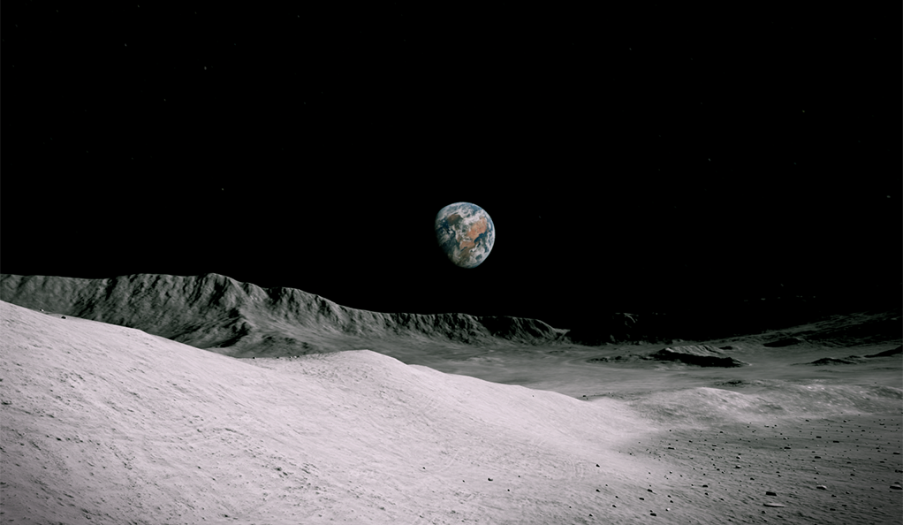
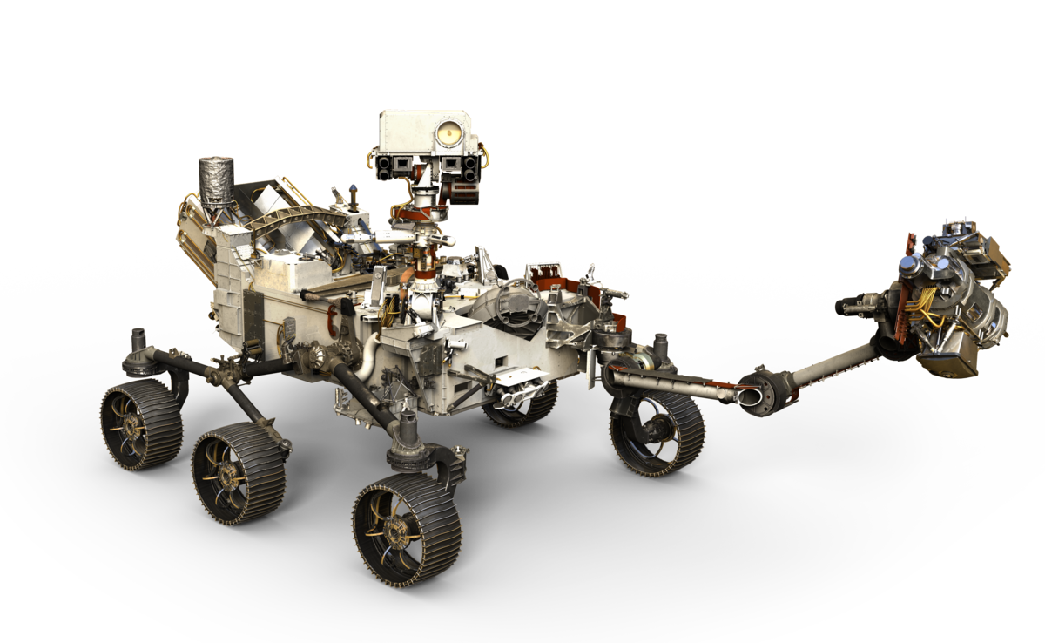
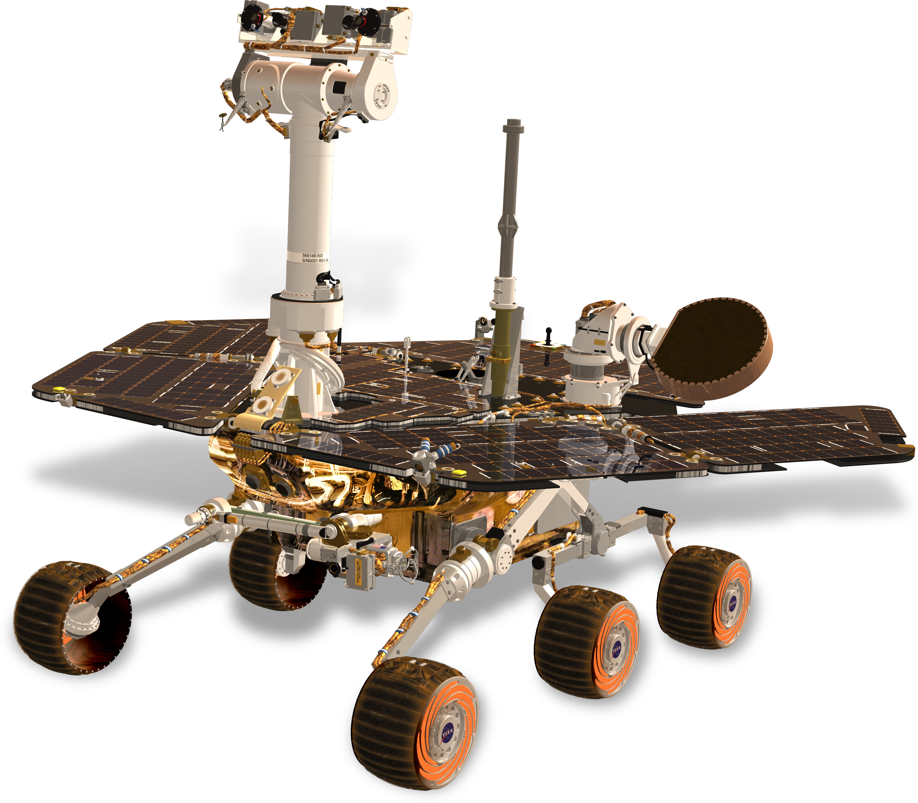
Team 517
Virtual Design Review 2
Cameron Barnes | Cole Gutknecht | Tyler Ince-Ingram| Rafael Meza | Michael Wyrick
Notes:
Hi everyone, we are Senior Design Team 517 and we are presenting on our project progress so far this semester

Slide 2
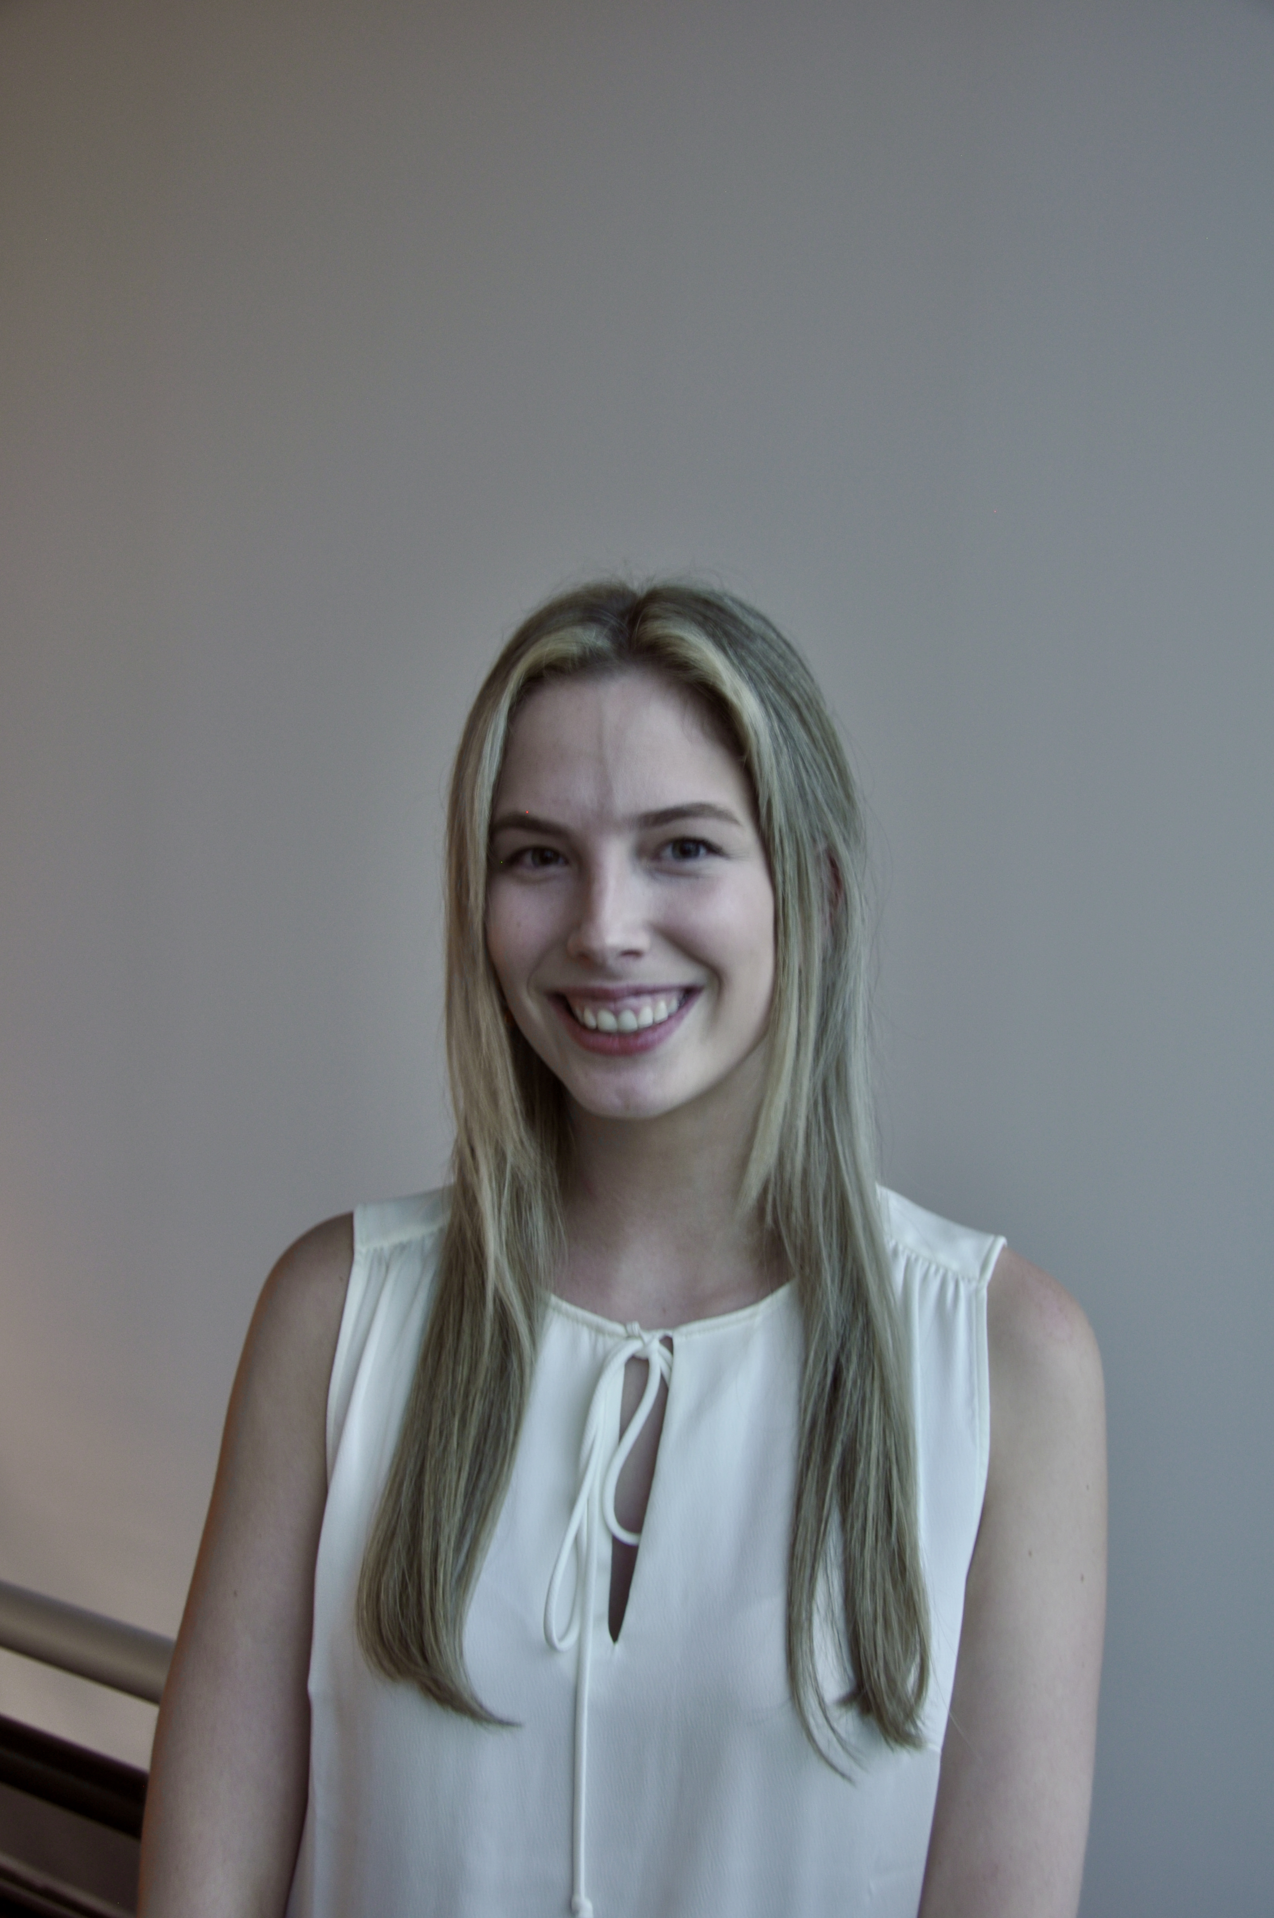
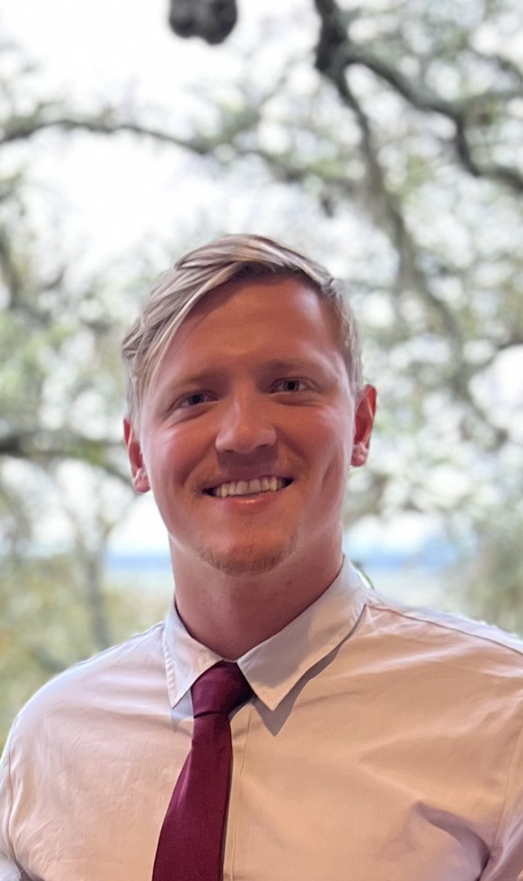

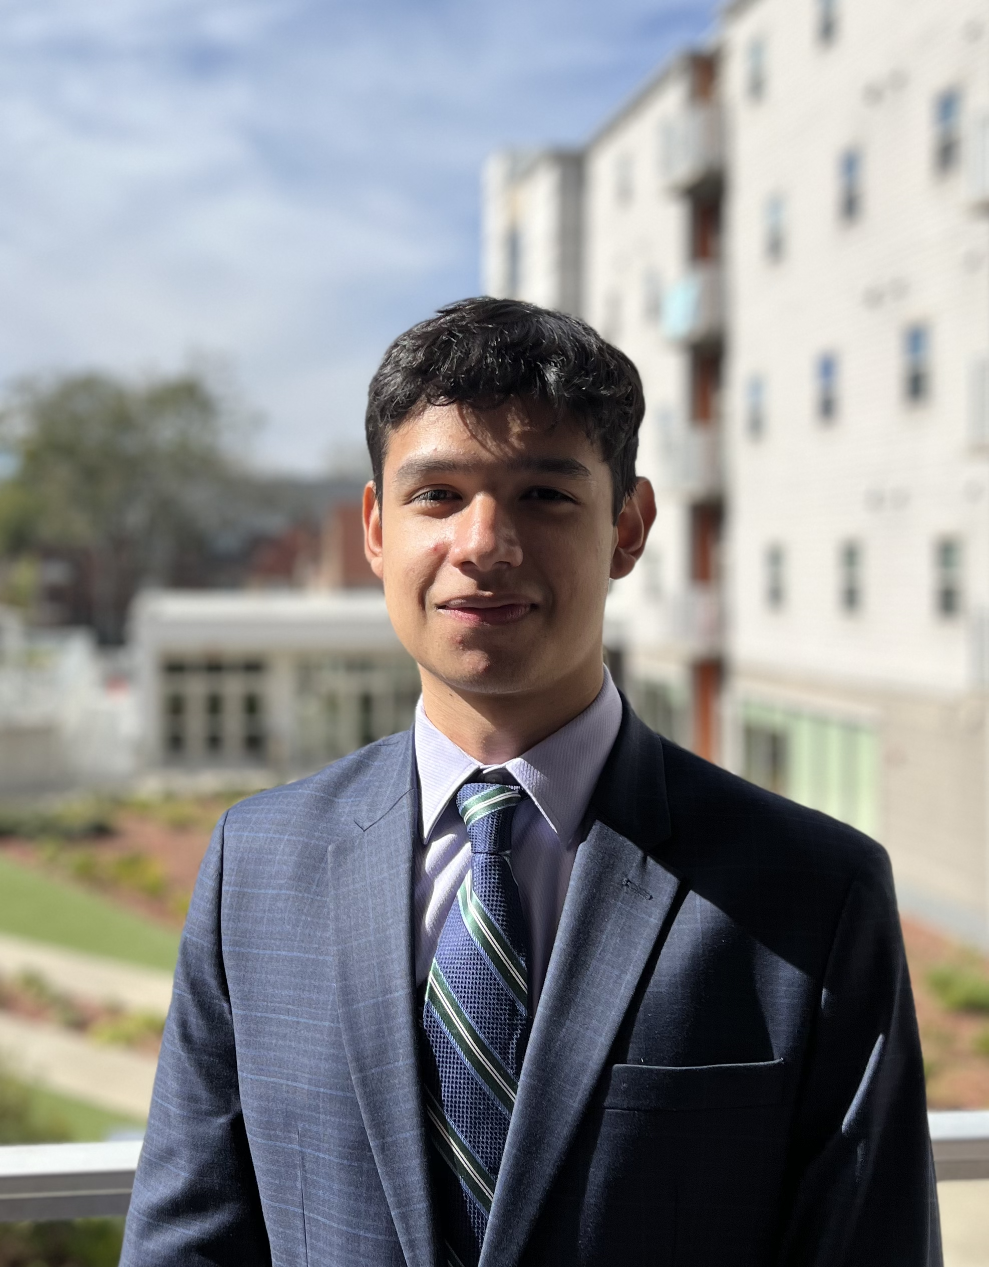
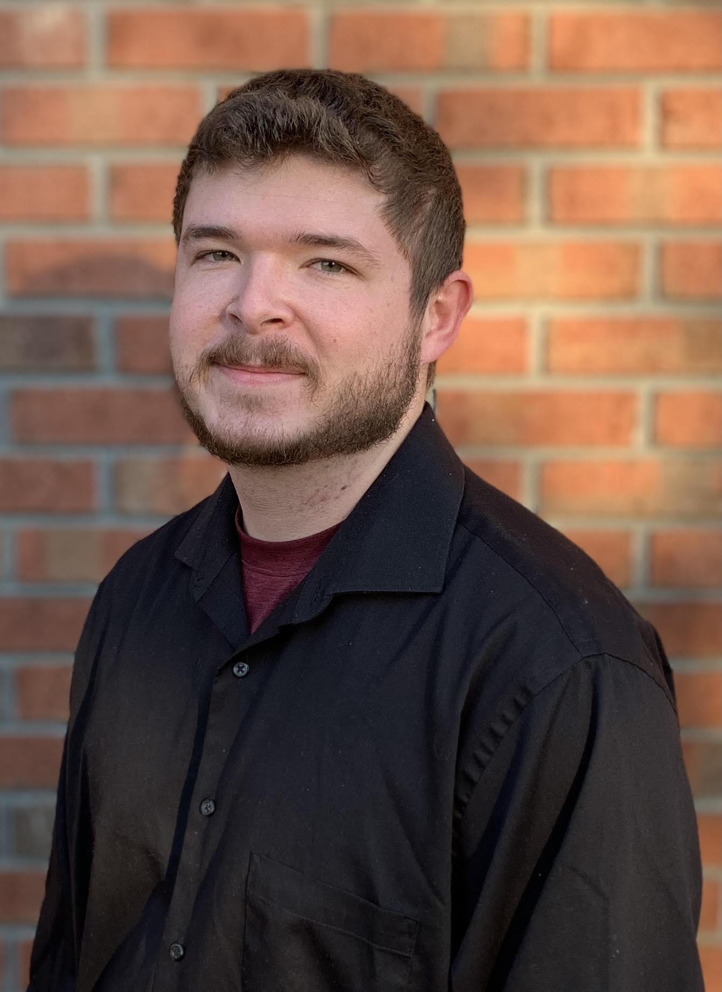
Team Overview
Cameron Barnes
Cole Gutknecht
Tyler Ince-Ingram
Rafael Meza
Michael Wyrick
Michael
Systems Engineer
Materials Engineer
Software Engineer
Dynamics Engineer
Design Engineer
Notes:
First we will start with some team introductions,

Slide 3
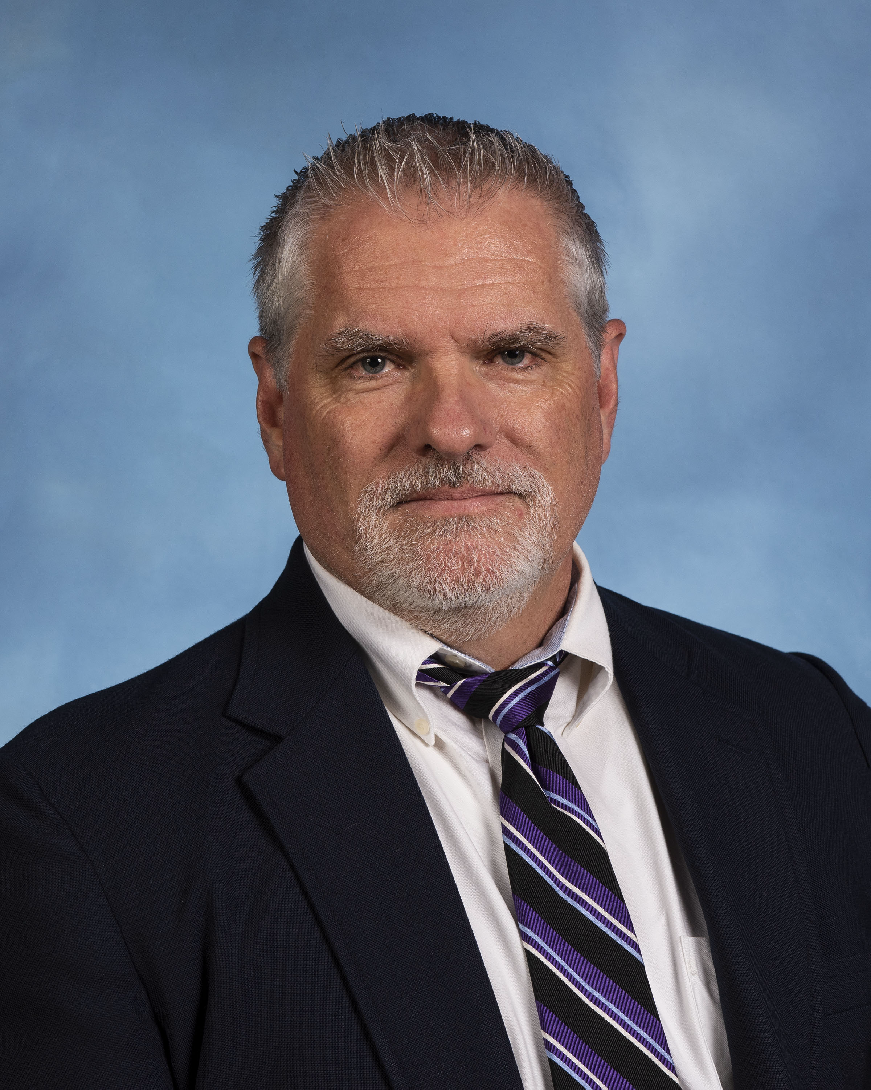

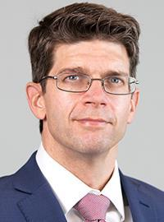
Sponsor and Advisor
Arthur Werkheiser
Dr. William Oates
Notes:
The sponsor for our project is Arthur Werkheiser, Deputy Branch Chief at Marshall Space Flight Center, acting as a liaison between our team and NASA. Our academic advisor is Dr. Oates who has research interests in Mechanics and Materials along with Non-linear control.

Slide 4
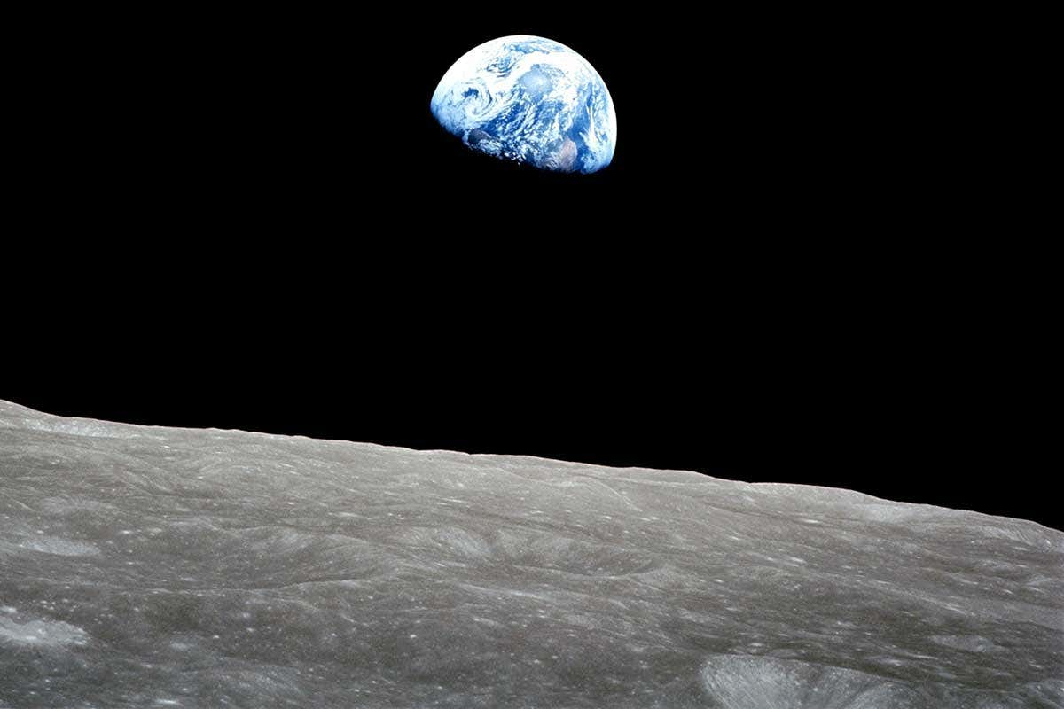
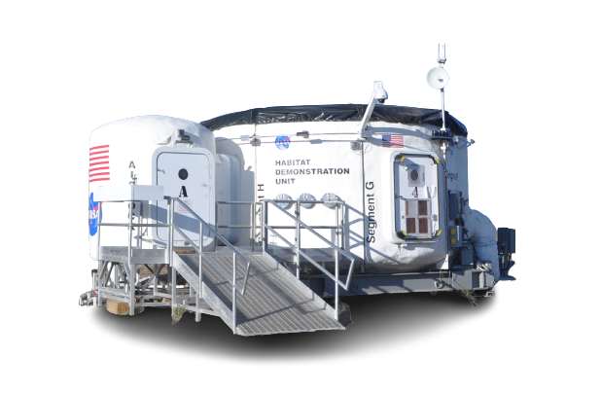
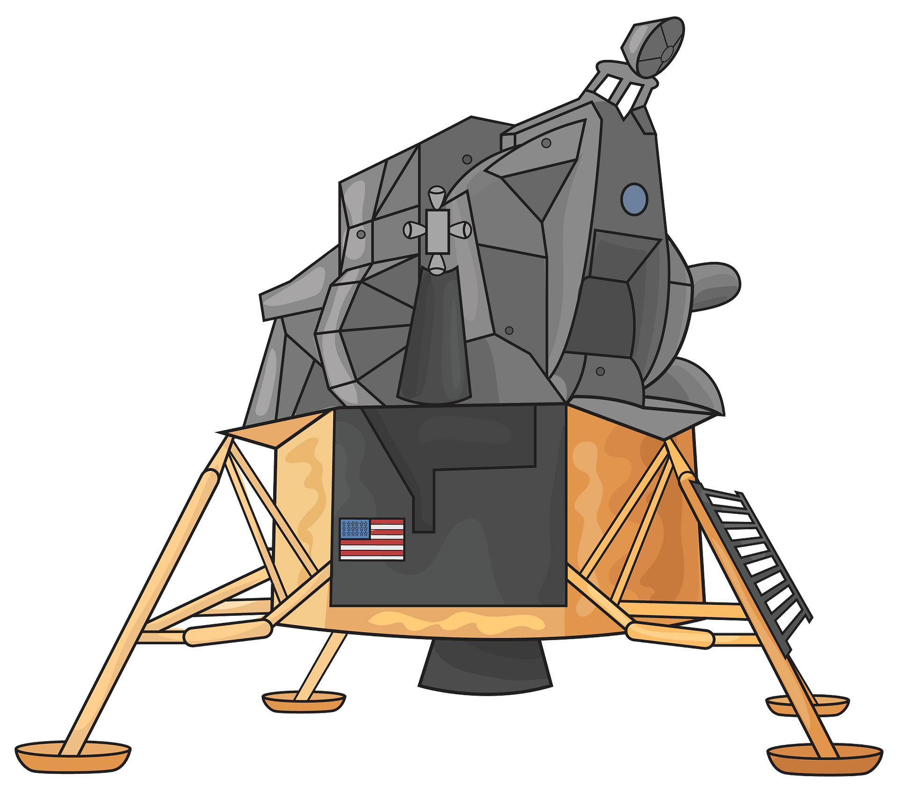
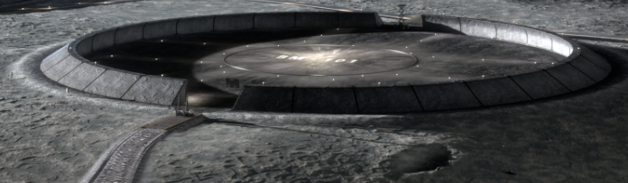
Project Description
Transport Heavy Loads on the Lunar Surface between the Landing Site and Habitation Area
Notes:
The objective of our project is to transport heavy loads on the lunar surface between an established landing site and habitation area.

Slide 5
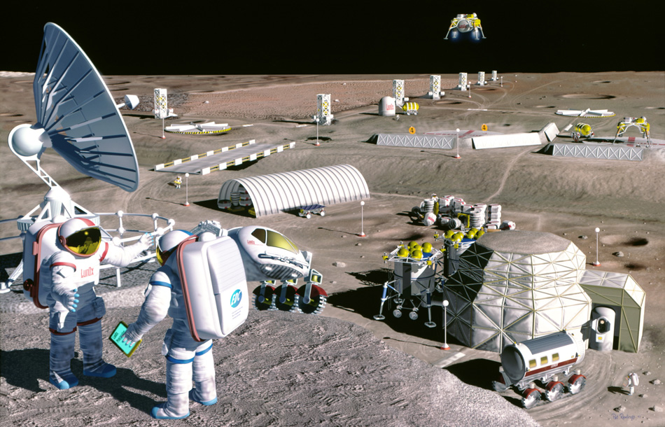

Background
Notes:
NASA’s Artemis project is the start of their plan for sustainable lunar development. The goal is that at some point in the future, we would have lunar bases and habitation areas acting as both scientific exploration centers and also a pitstop on the way to Mars. The plan is that these areas will have semi- self-sufficient since the most expensive part of space travel is getting from the earth to the moon in the first place, development efforts on the moon will keep cost down. However, some sort of device will be needed to help transport cargo around these habitats and also unload cargo from the nearby landing site which is where our device, which we are calling the Hermes transport vehicle, would come in.

Slide 6
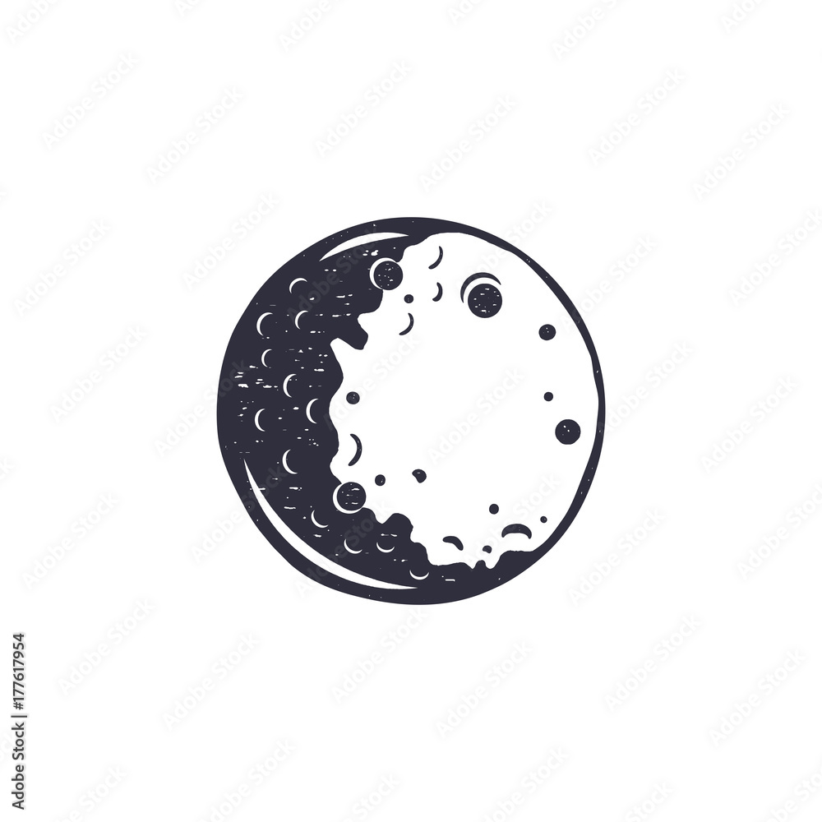


HERMES
ACRONYM:
Heavy Equipment Rover for lunar Mobility, Expansion, and Sustainment
SYMBOLISM:
God of Transportation Protector of Travelers
Notes:
Our team name for our design is Hermes. The name stands for Heavy Equipment Rover for lunar Mobility, Expansion, and Sustainment. Because our objective is transporting goods hermes was also the God of Transportation Protector of Travelers.

Slide 7




Challenges
Rough
Terrain
Dust Mitigation
Temperature Extremes
Radiation
Notes:
Designing a device for the moon comes with a unique set of challenges:
The lunar terrain is harsh and rocky, consisting of small and large craters caused from millions of years' worth of Metroid damage. The terrain is also not flat so elevation change is common on the lunar surface.
Dust Mitigation/Regolith: The surface is coated in regolith, a layer of loose rock and dust that is extremely fine grained and abrasive. Additionally, it will kick up into dust plumes which will stick to all material.
The weather varies vastly depending on the lunar cycle. More concerning is the lunar night where the device must withstand extremely cold temperatures for 14 days.
Additionally, radiation can become a concern for our product, specifically the electronic components, overtime

Slide 8





Key Goals
Adaptable
Lightweight
Robust
Lifespan
Safe
Notes:
The following items are key design goals for our product. It must be lightweight, this is because reduction in weight translates to lower costs of delivery to the moon, therefore, with the cost of transport per mission being about $2.0 million per kilogram, so weight, mass, and volume are of the essence to make our design cost effective
It must be a robust design due to the previously discussed challenges surrounding the lunar environment and terrain, regolith and dust can be detrimental to the design if not adequately protected.
The design should have a level of adaptability for a variety of possible payloads with respect to size, shape, and mass.
Another goal for our product is that it will last at least one year on the moon to keep transportation costs low making it cost-effective and also to decrease the amount of lunar waste that would be produced from a short-term device.
Our last keygoal is that All NASA and United States safety and technical standards are met as a baseline of safety for the operating crew and the environment. Additionally, NASA usually expects a factor of safety around 1.4,

Slide 9
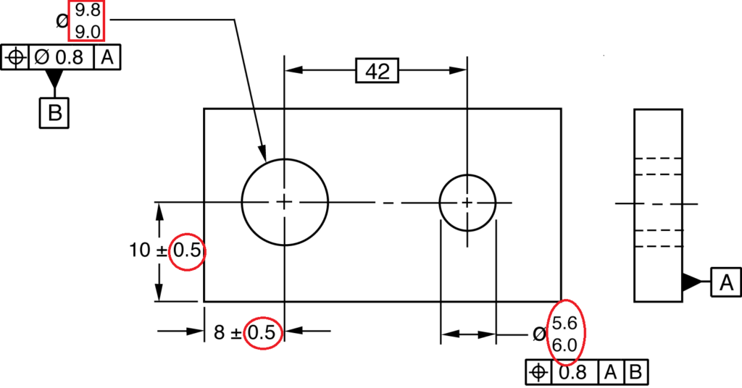
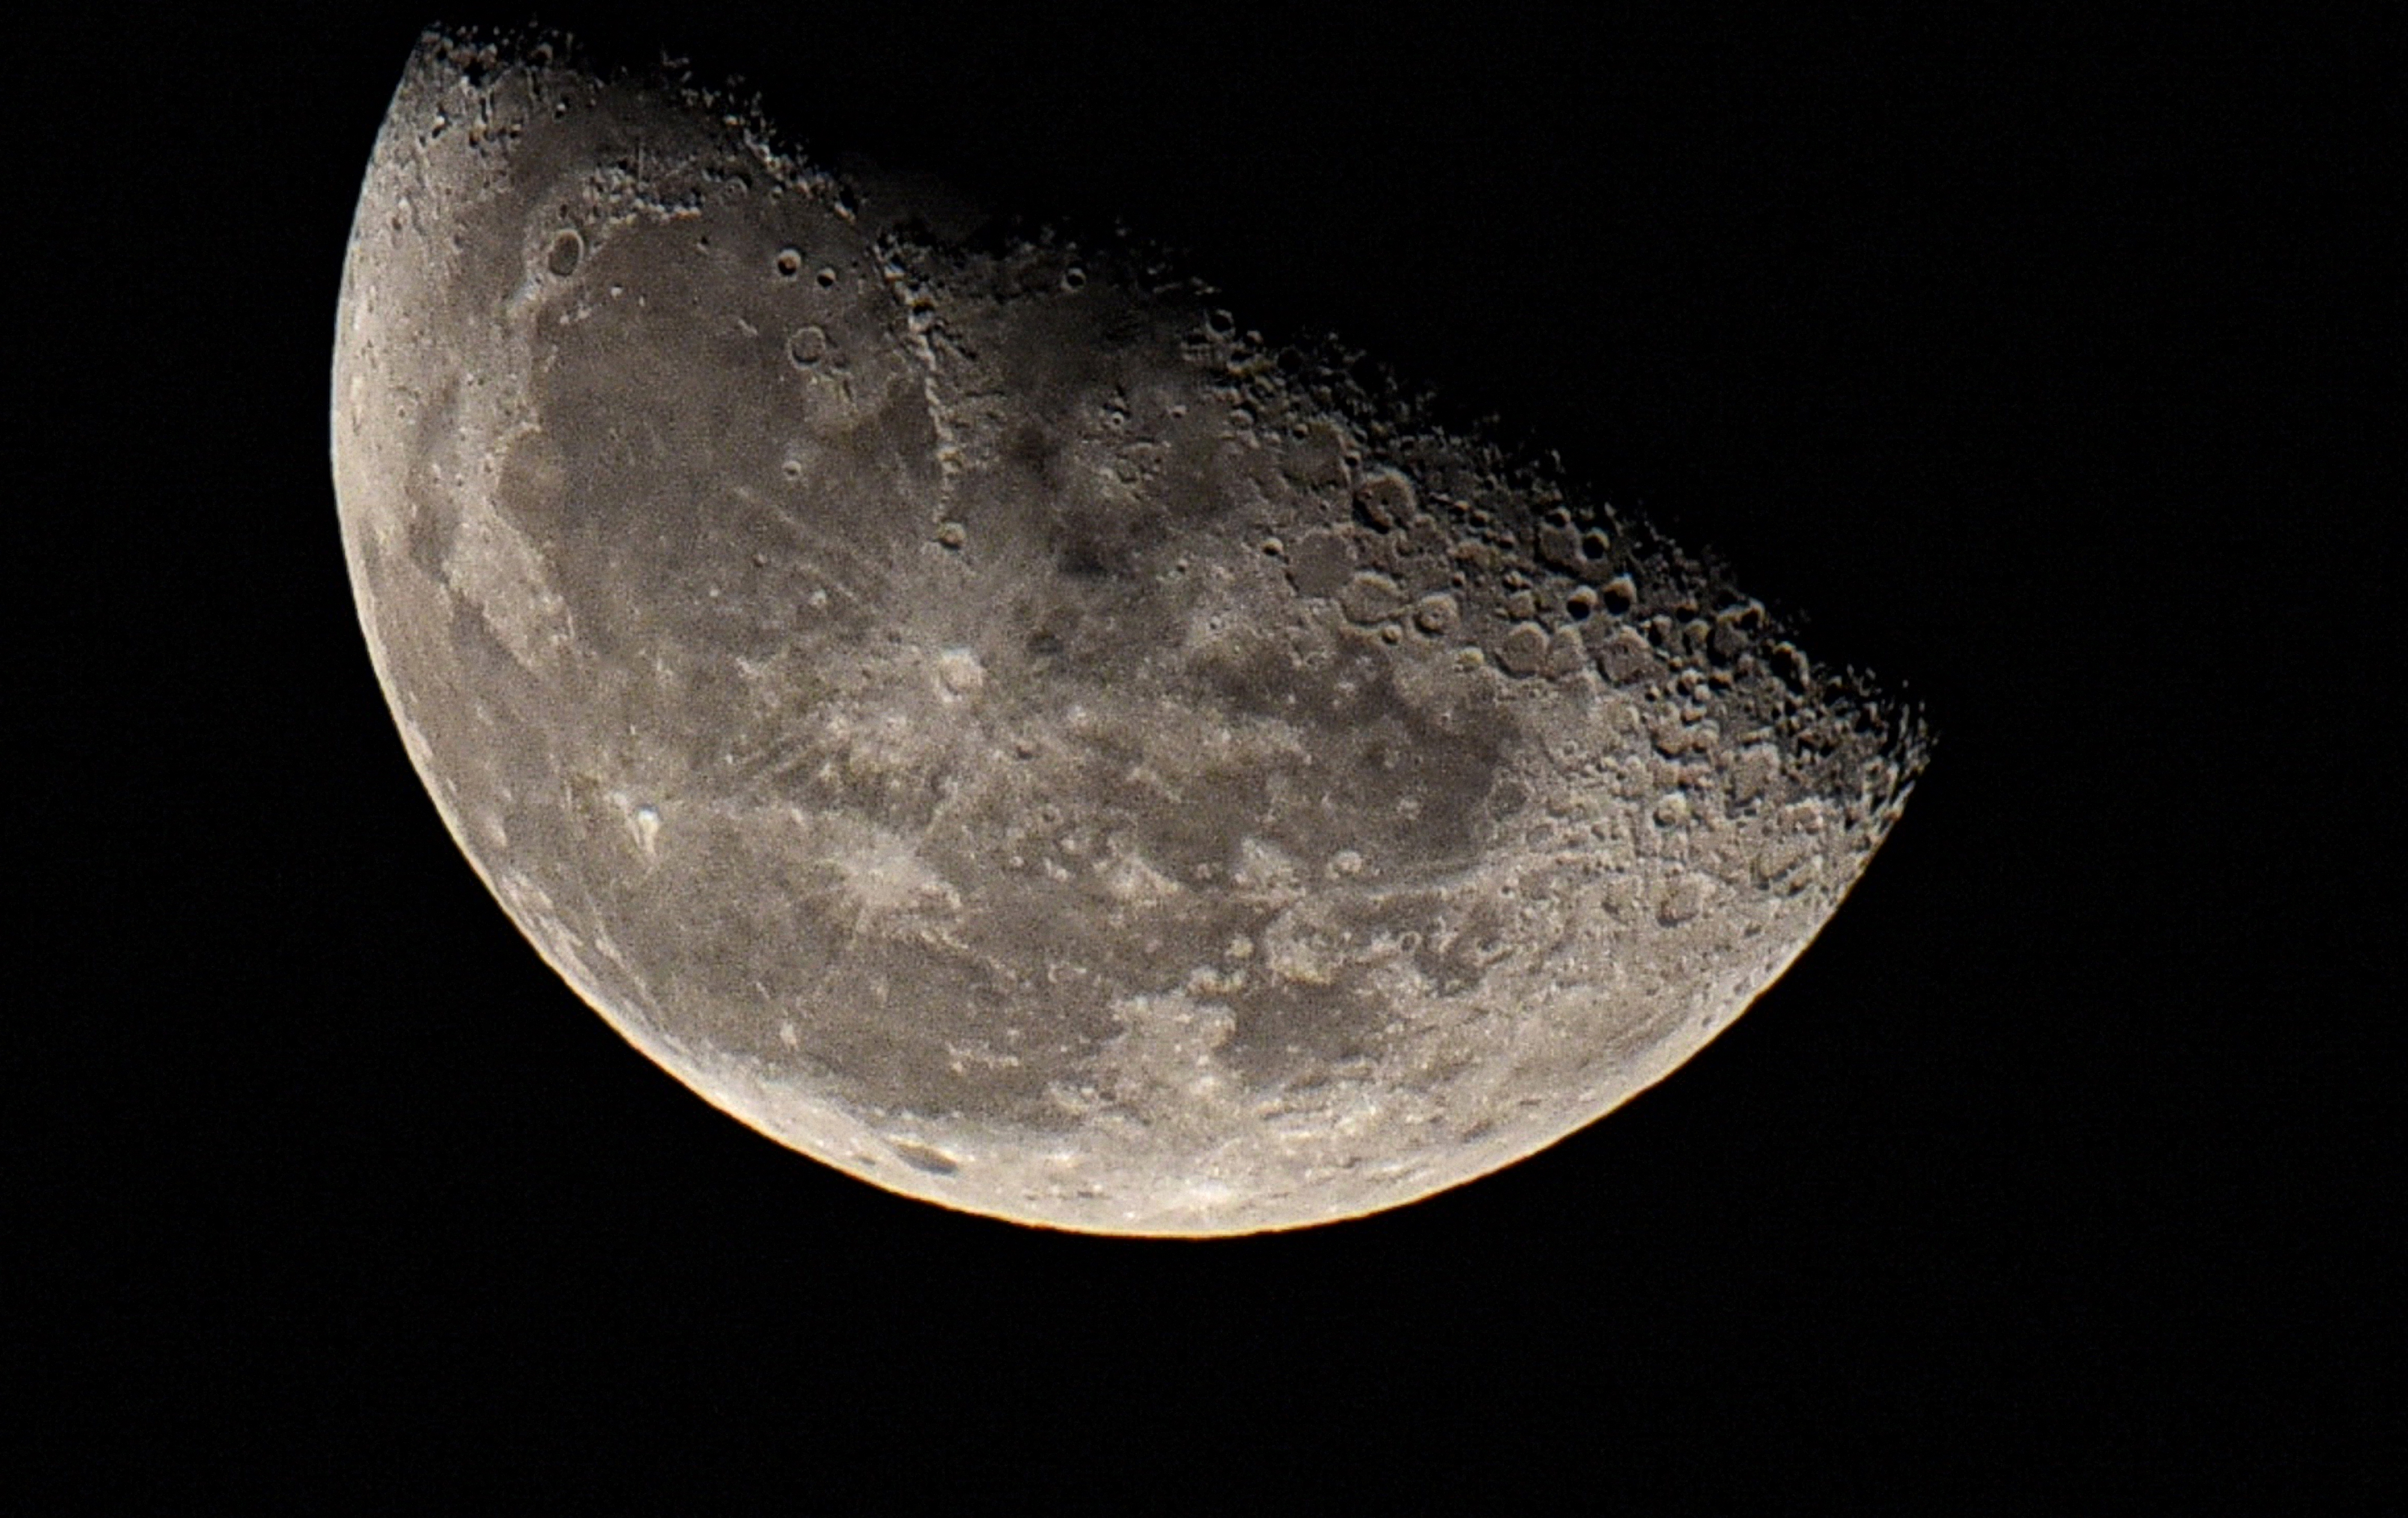

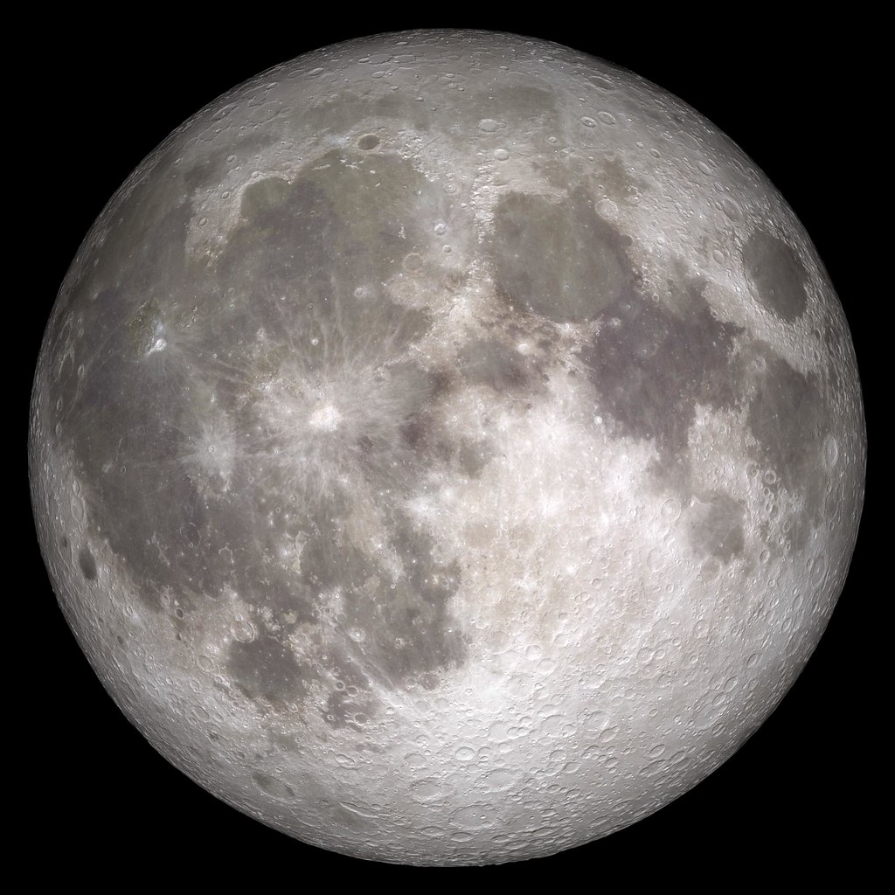

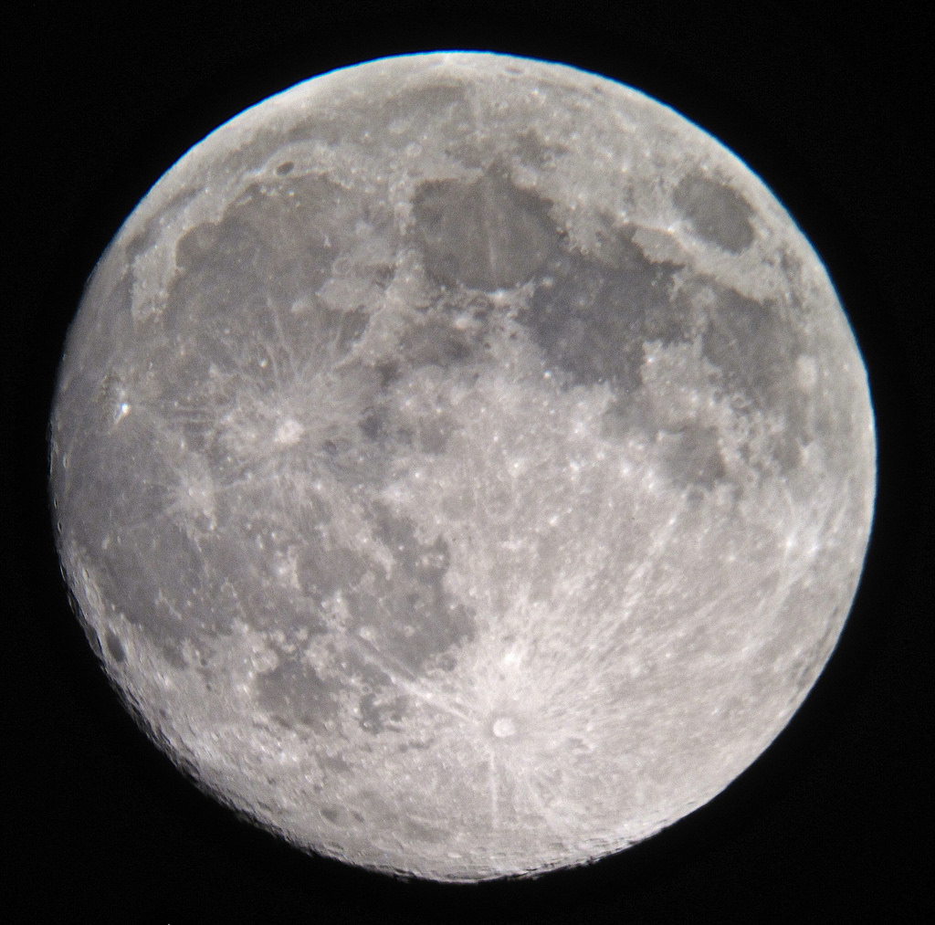




Assumptions
$$\frac{1}{6}$$
1 TON
TON
1 km
$$\frac{1}{6} TON$$
*Not drawn to scale
Notes:
the payload will have a maximum mass of 1 metric tons on Earth. This amount can be divided by 6 for lunar applications since the gravity is much lower than that one Earth (about 1.62 m/s^2)
The system will be built with loose tolerances to keep cost low and to help with dust mitigation efforts. However, this should not take away from the device functionality.
???? Idk ---low cost, help with dust (robust)
it is assumed the device should survive the lunar night, but there is no requirement for it to transport loads during that time.

Slide 10
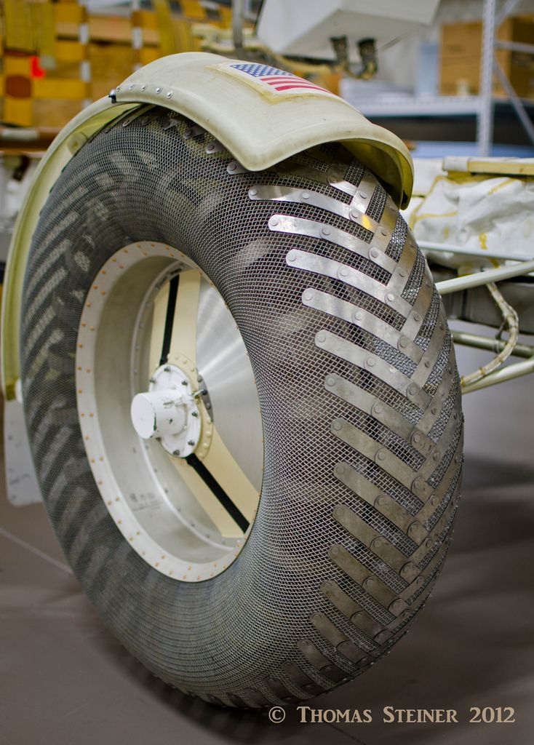
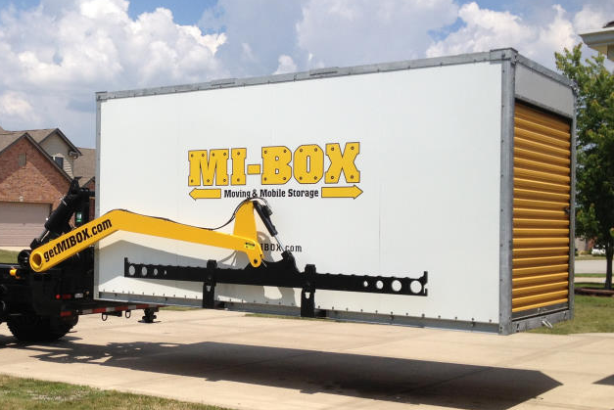
New Assumptions
Notes:
The landing site of the aircraft should be within 1 km of the habitation area where the cargo will be deposited. Preferably our device could travel longer distances but it should at a minimum be able to travel this kilometer.
It is assumed the device have to withstand temperatures ranging between 140 K (~133.1℃) and 400 K (~126.8℃). This accommodates the temperature for both the periods of lunar night and day. This also assumes our landing site to be far away from the significant weather extremes of the polar regions where temperatures can drop to around 20 degrees kelvin.
It is also assumed that the materials purchased will be budget-friendly. The end product will be an earth-bound prototype and we will be buying materials suitable to this application.

Slide 11
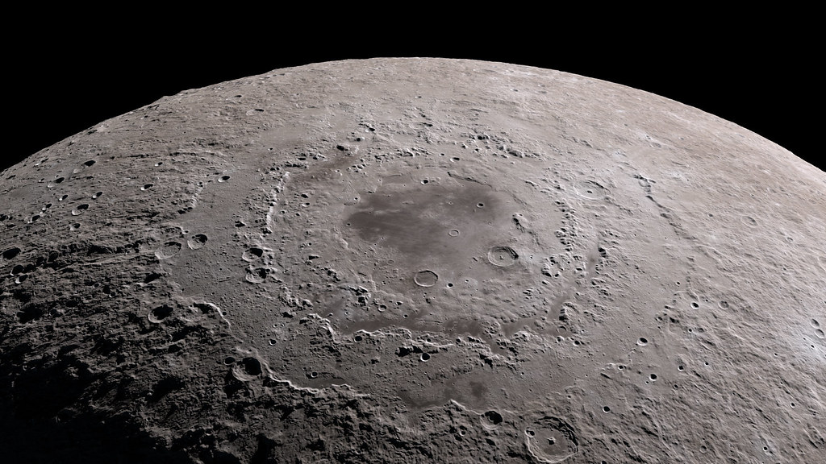

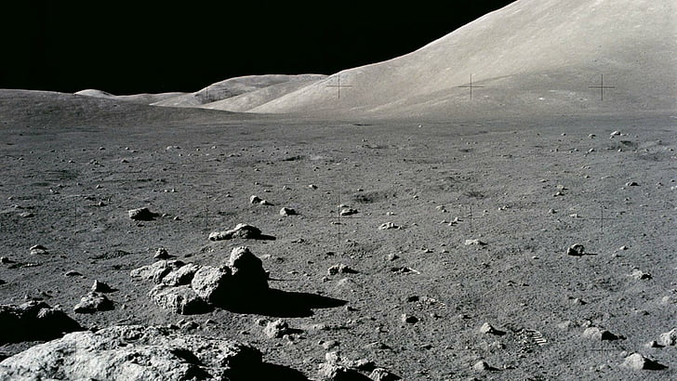




Functional
Resolution
Lifting
Power
Transport
Environmental
Tolerance
Notes:
Transporting heavy loads is our main objective
All of the other functions such as power, environmental tolerance and lift assist will be considered as key constraints because they are important for the purpose of this project and will be accounted for when building our final prototype but might not be fully operational by April. However, for functions such as power, the bare minimum should be met so that the device can be operational and undergo testing. The reasoning for this is to focus our efforts on the primary objective and not let other aspects creep in and cause us to stray away from our main goal.

Slide 12




Targets and Metrics
Survivability
Activation
Structural
Design
Power
Notes:
Our main targets are power, activation, and structural design. After further consideration survivability is now one of our assumptions so we no longer are focusing on it as one of our targets.

Slide 13

Targets and Metrics
Should lift 1400 kg
Constrained to 7.5 meter diameter
8 ampere hour battery
Lift maximum weight
Fit within rocket
Convert power to movement
Notes:
Our targets are listed as most important to least important. Starting off our design should lift 1400 kg which is our maximum cargo weight. Next our design has to fit in the rocket so its packaged length needs to fit in a 7.5 diameter. Our third most important constraint is that we need to convert power to movement which will be done with a 8 ampere hour battery.

Slide 14
Targets and Metrics
Reduce volume by at least 25%
Inclines up to 20 degrees
1 foot of ground clearance
Collapsible volumetric footprint
Stability transporting over rough terrain
Ground Clearance

Slide 15


Concept Generation
5 Medium Fidelity
100
Concepts
3 High Fidelity

Slide 16






Medium Fidelity Overview
Rear
Lift System
Modular Cargo Bed
Bipedal
Forklift
Snake
Fang Lift
Honeycomb

Slide 17
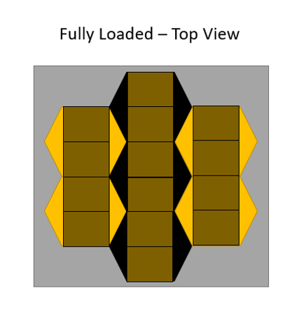
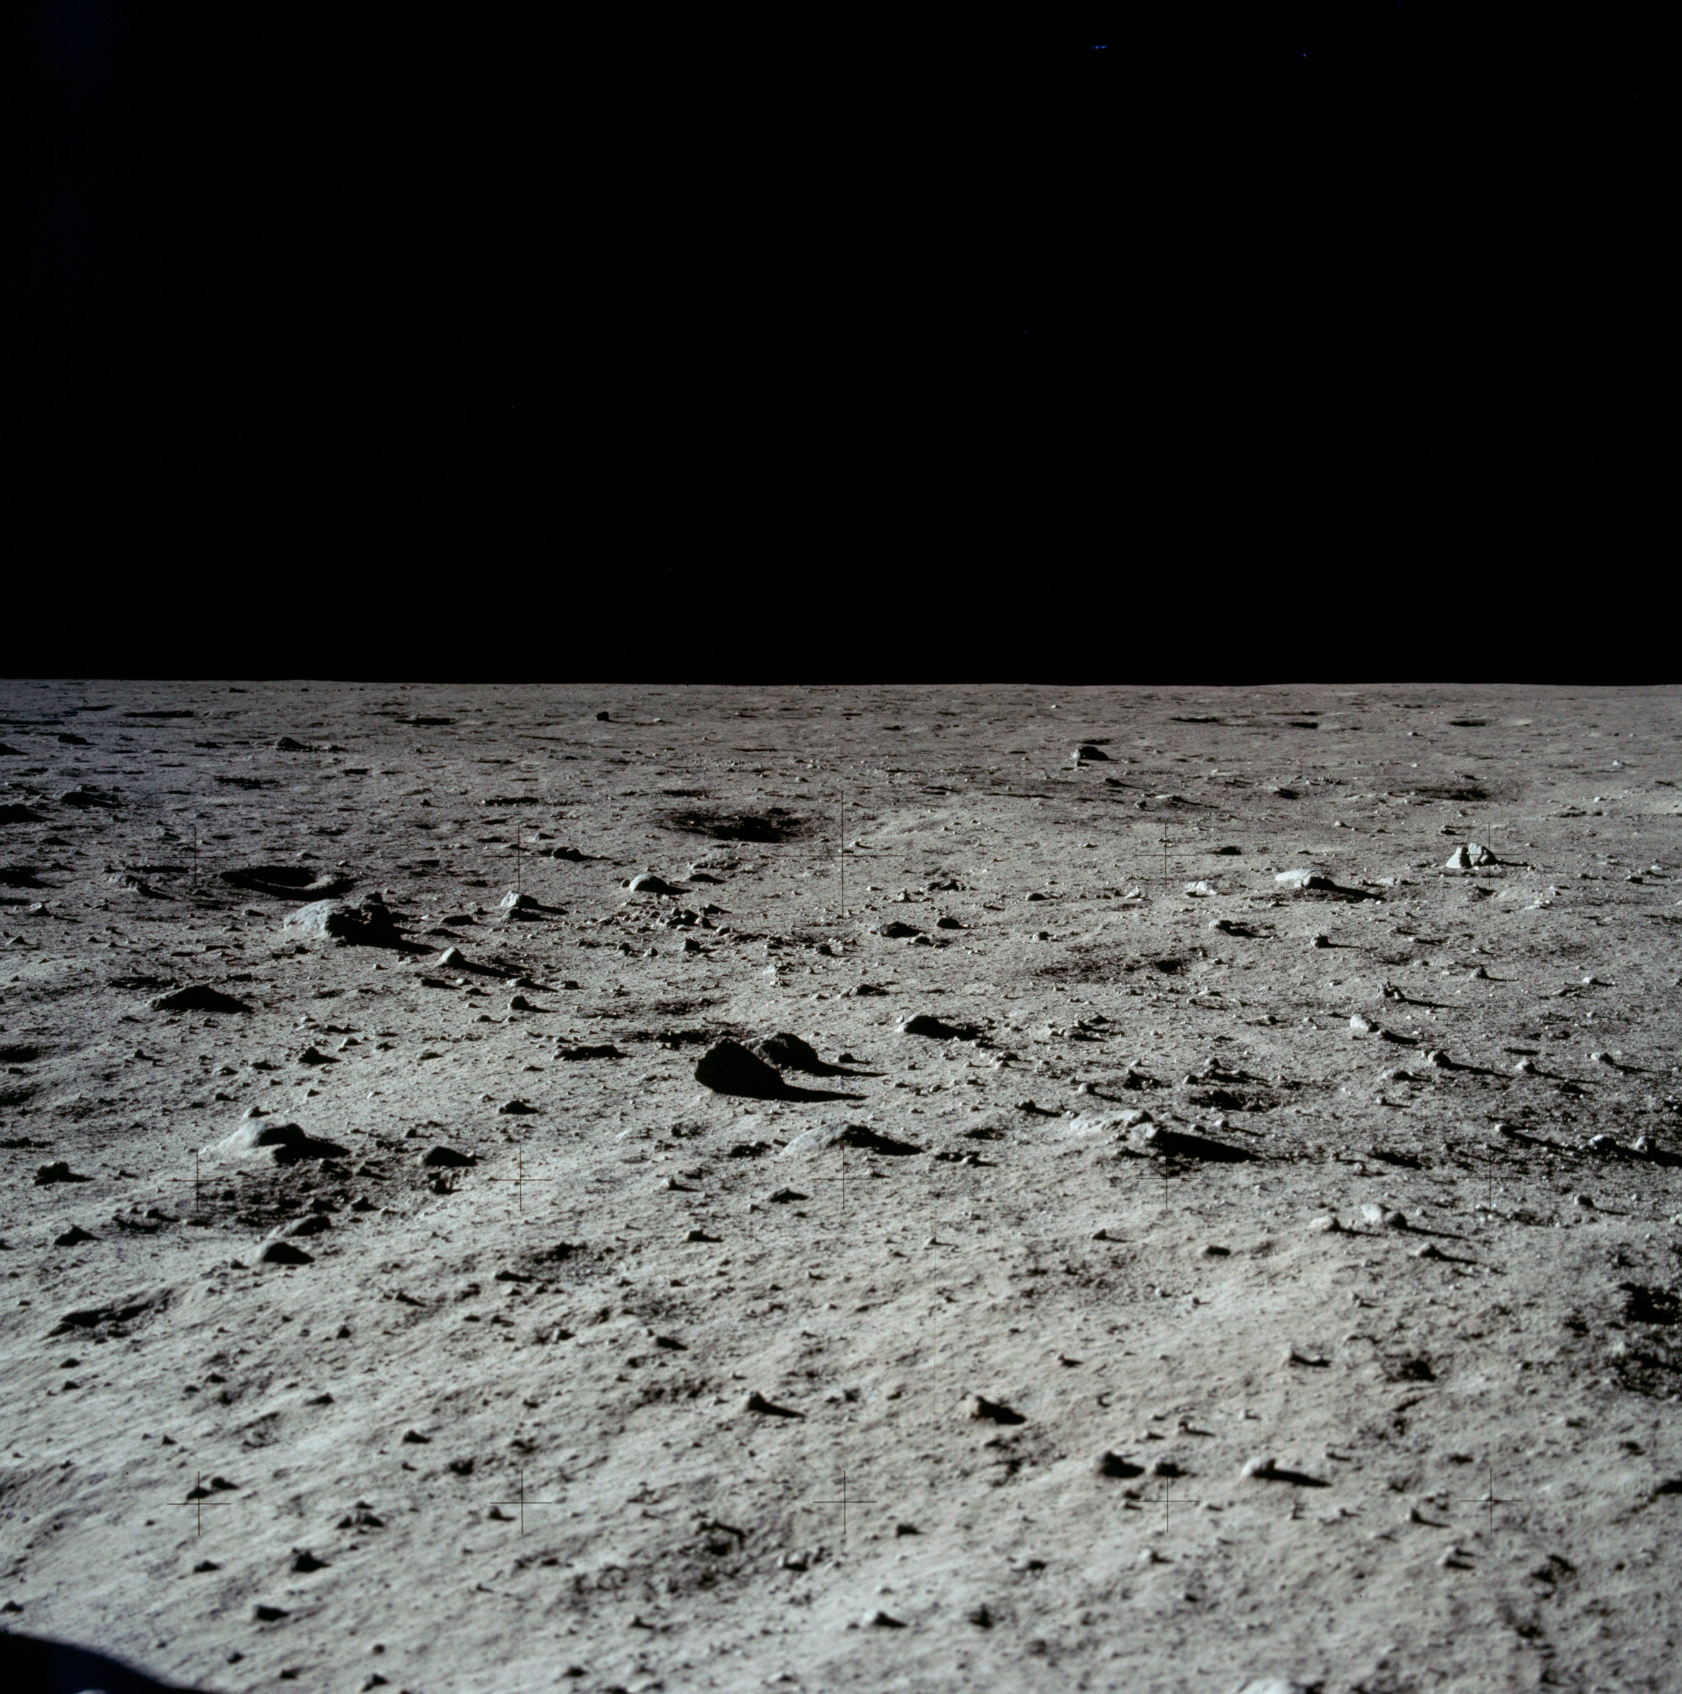
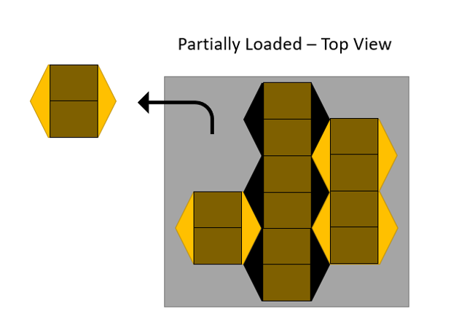
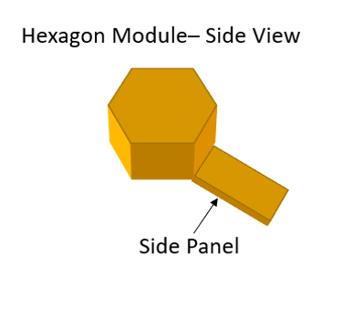
Honeycomb

Slide 18
Honeycomb

Slide 19
Honeycomb

Slide 20
Bipedal Forklift

Slide 21
Bipedal Forklift

Slide 22
Bipedal Forklift

Slide 23
Rear Lift System

Slide 24
Rear Lift System

Slide 25
Rear Lift System

Slide 26
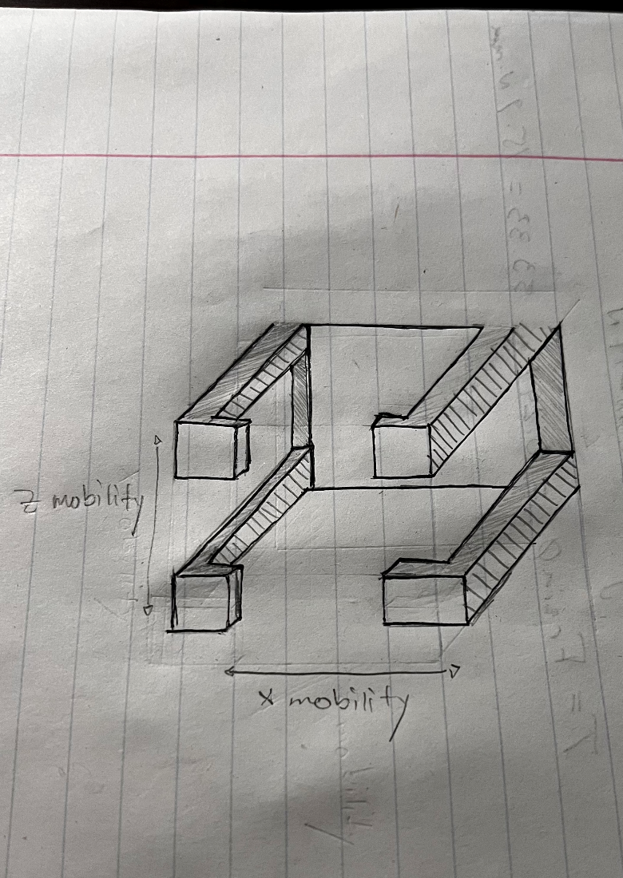
Snake Fang Lift
View of Front Design

Slide 27
Snake Fang Lift
View of Front Design

Slide 28
Snake Fang Lift
View of Front Design

Slide 29
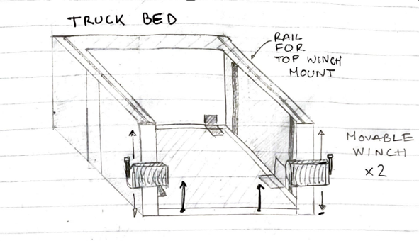
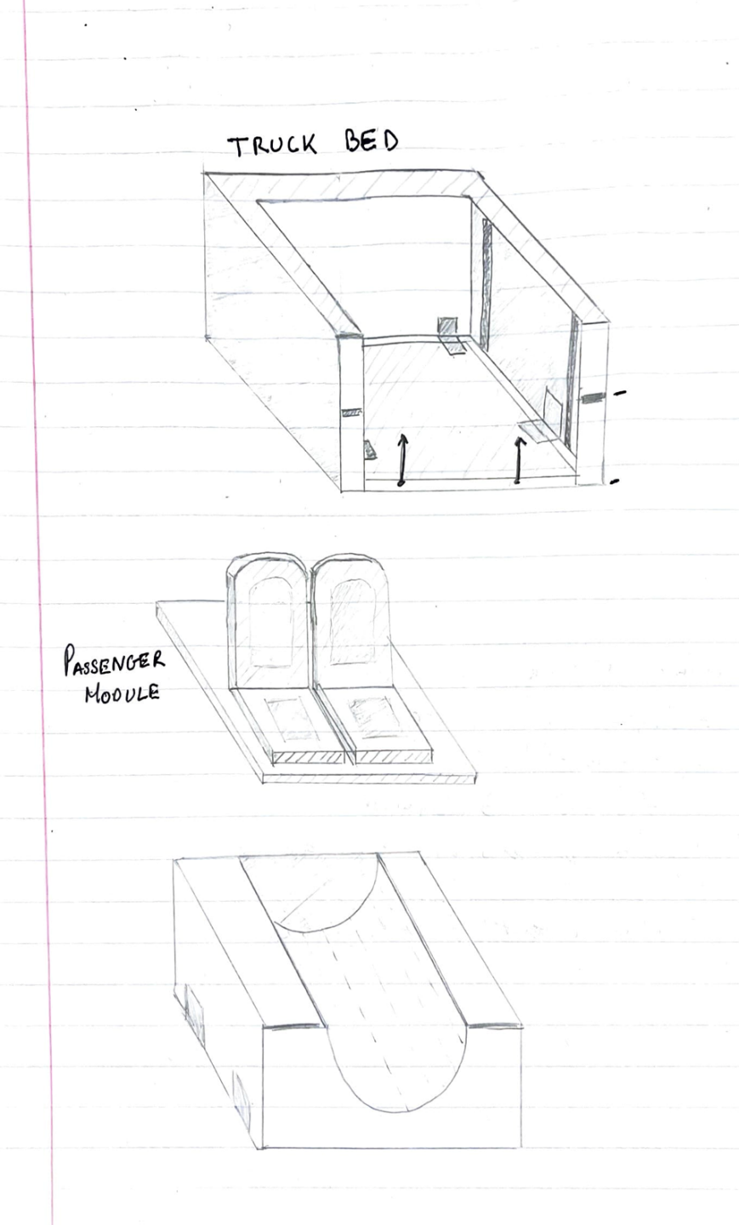
Modular Cargo Bed

Slide 30
Modular Cargo Bed

Slide 31
Modular Cargo Bed

Slide 32
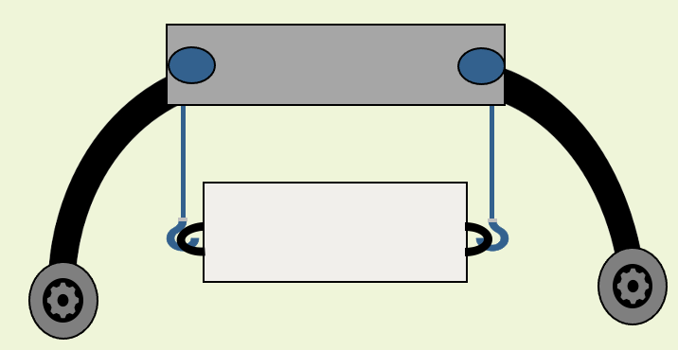
High Fidelity Overview
Seesaw
Assist System
Quadzilla
Assist System
Sunflower
Lift System

Slide 33
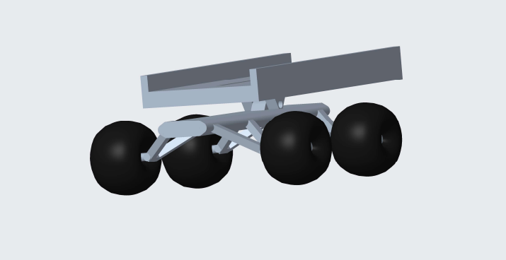
Seesaw Design
DRAWING
CAD MODEL

Slide 34
Seesaw Design

Slide 35
Seesaw Design

Slide 36
Seesaw Design

Slide 37
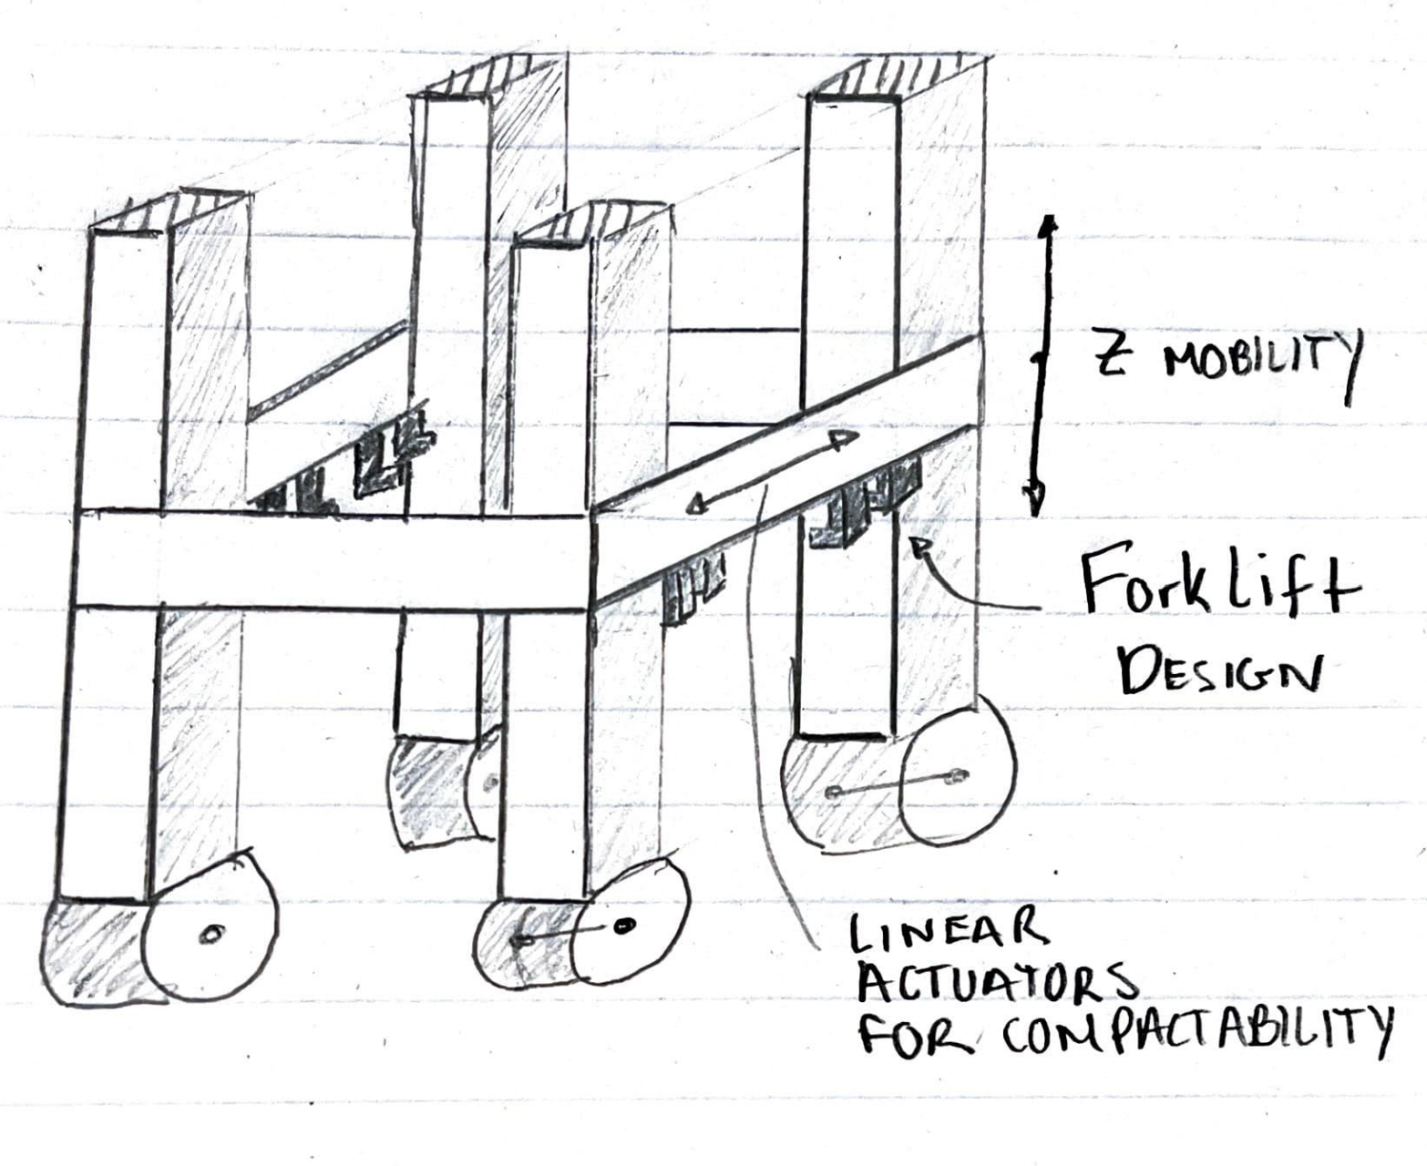
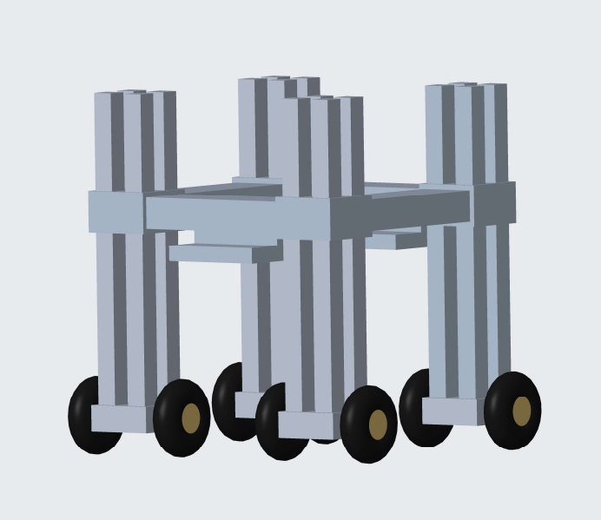
Quadzilla Design
DRAWING
CAD MODEL

Slide 38
Quadzilla Design

Slide 39
Quadzilla Design

Slide 40
Quadzilla Design

Slide 41
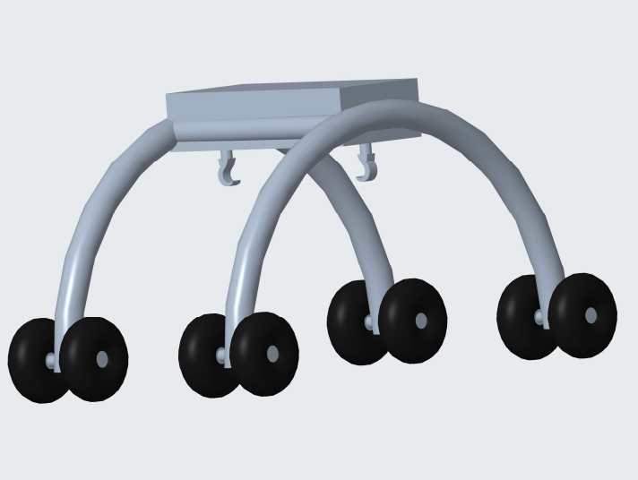
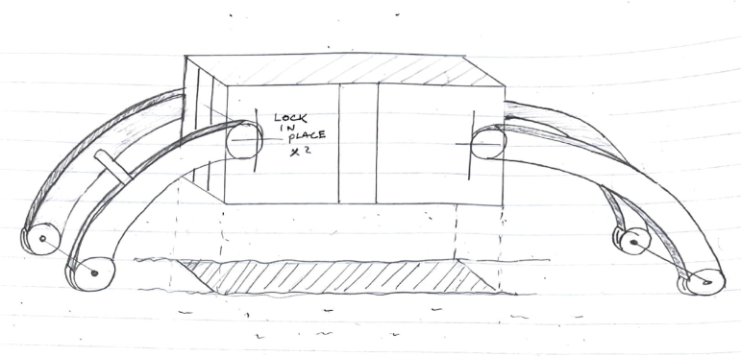
Sunflower Design
DRAWING
CAD MODEL

Slide 42


Sunflower Design

Slide 43
Sunflower Design

Slide 44
Sunflower Design

Slide 45



Concept Selection
House of Quality
Stable/Steady
Movement
Lifts
Max Weight
Converts Power
to Movement
Compact

Slide 46
Concept Selection
Pugh Chart: First Iteration

Slide 47
Concept Selection
Pugh Chart: Second Iteration

Slide 48
Concept Selection
Analytical Hierarchy Process
Concept | Alternative Value
Quadzilla | 0.503
Sunflower | 0.242
Seesaw | 0.255

Slide 49
Final Selection
Stable Design
Greatly Reduces its Volumetric Footprint
Low device weight, high lift capability
QUADZILLA
Adaptable

Slide 50
Initial Design
Fork Lift Mechanism
Lift Attachment allows vertical movement
Four Outer Rigid Post
Double Wheels (360 Movement)
Linear Actuators on each side

Slide 51
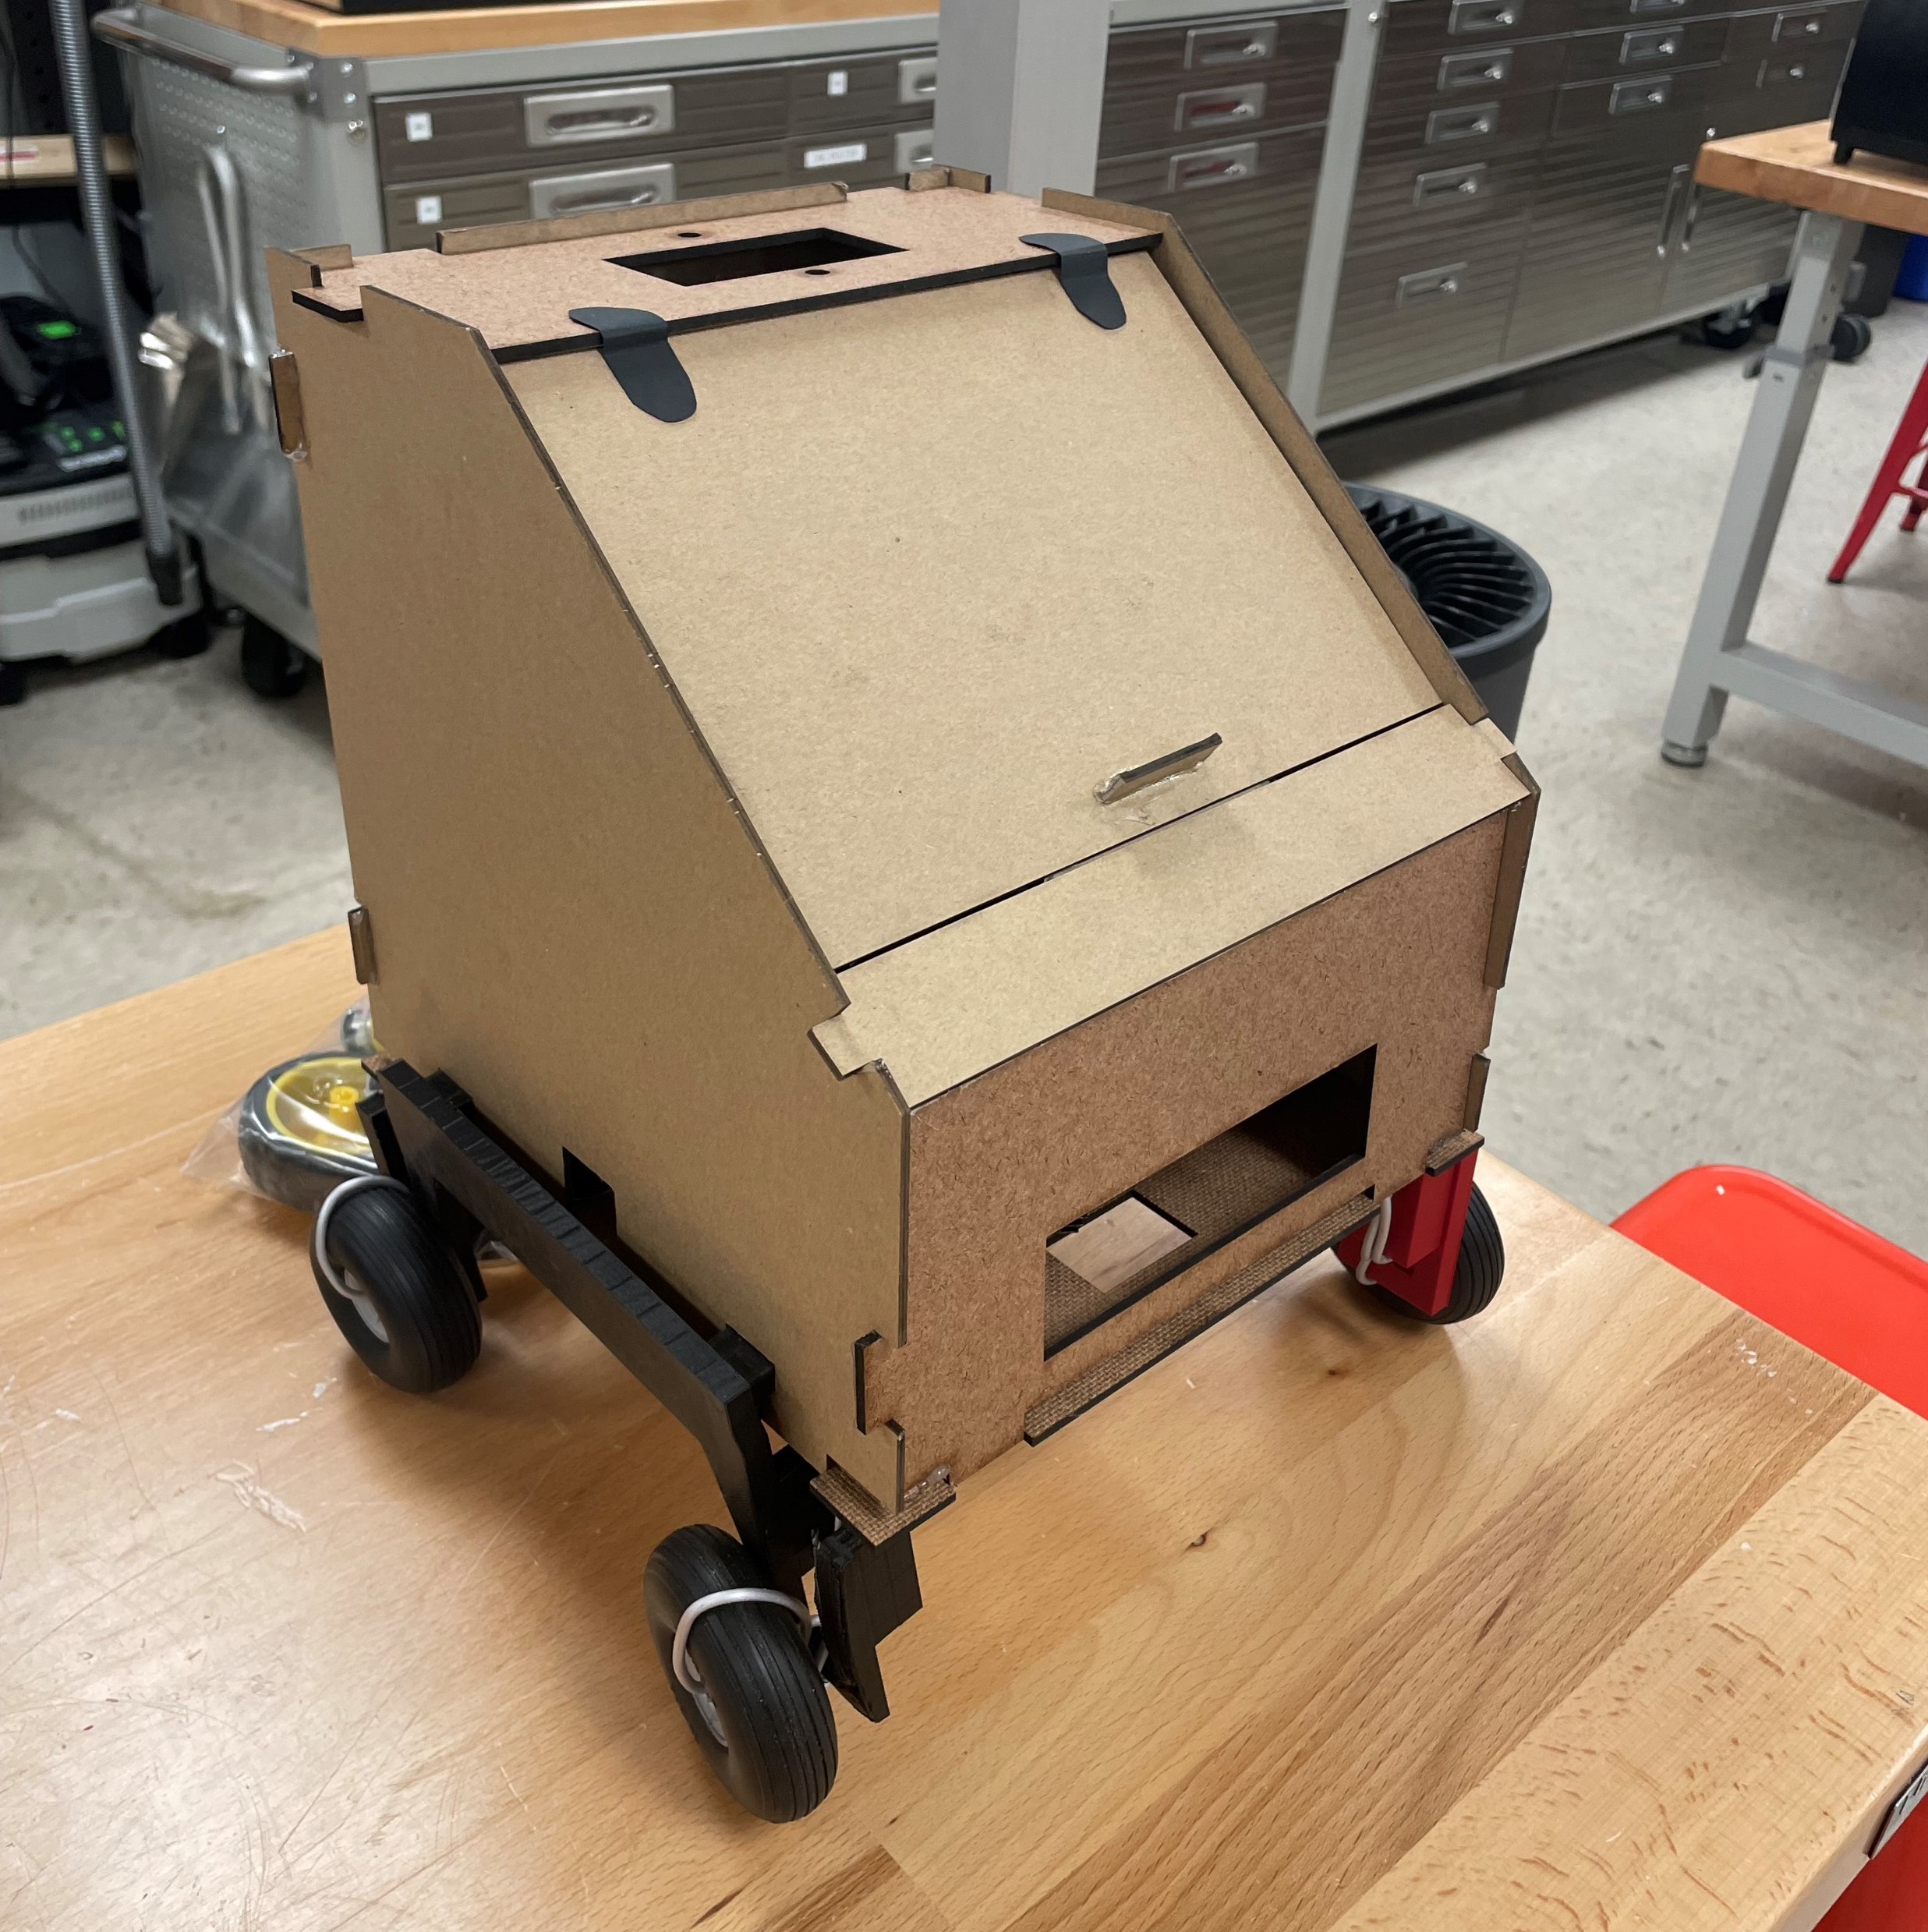
Mechatronics Prototype
Main Objectives:
Distance Awareness
Obstacle
Awareness
Mobility
Progress:
Advanced Mechanical Prototype
Code Writing and Testing
Notes:
One of our group members is creating a preliminary prototype of our design in mechatronics. It will move by line following and will sense when an object is in its path using 2 infrared and 1 ultrasonic sensor. When it gets close enough to the object it will stop. It will output the coordinates, through the use of an accelerometer, and grab the object. At this stage, an advanced mechanical design has been created using CAD modeling, laser cutting, and 3D printing. The hope is that the design wil aid us in some of design challenges including mobility, location awareness, and load awareness.

Slide 52
Future Prototyping Plan
1
Preliminary Prototype 12/2
2
Advanced Mechanical Prototype 1/20
3
Final Mechanical Prototype 2/25
4
Test Prototype at MSFC March
Notes:
Our team hopes to create another preliminary prototype that better resembles the physical features of our selected design before the end of the semester. Additionally, we plan to create a more advanced prototype early on in the spring semester before starting our final prototype in Mid January. Our goal is to have a mostly working design by early March which we can test at the Marshall Space Flight Center before Senior Design Day. At MSFC, they have a regolith field which will give the team a better idea of how our design will perform in a lunar environment.

Slide 53

Conclusion

Slide 56










Slide 58
MiBOX
CARGO

Slide 60
Side View
Front View

Slide 64
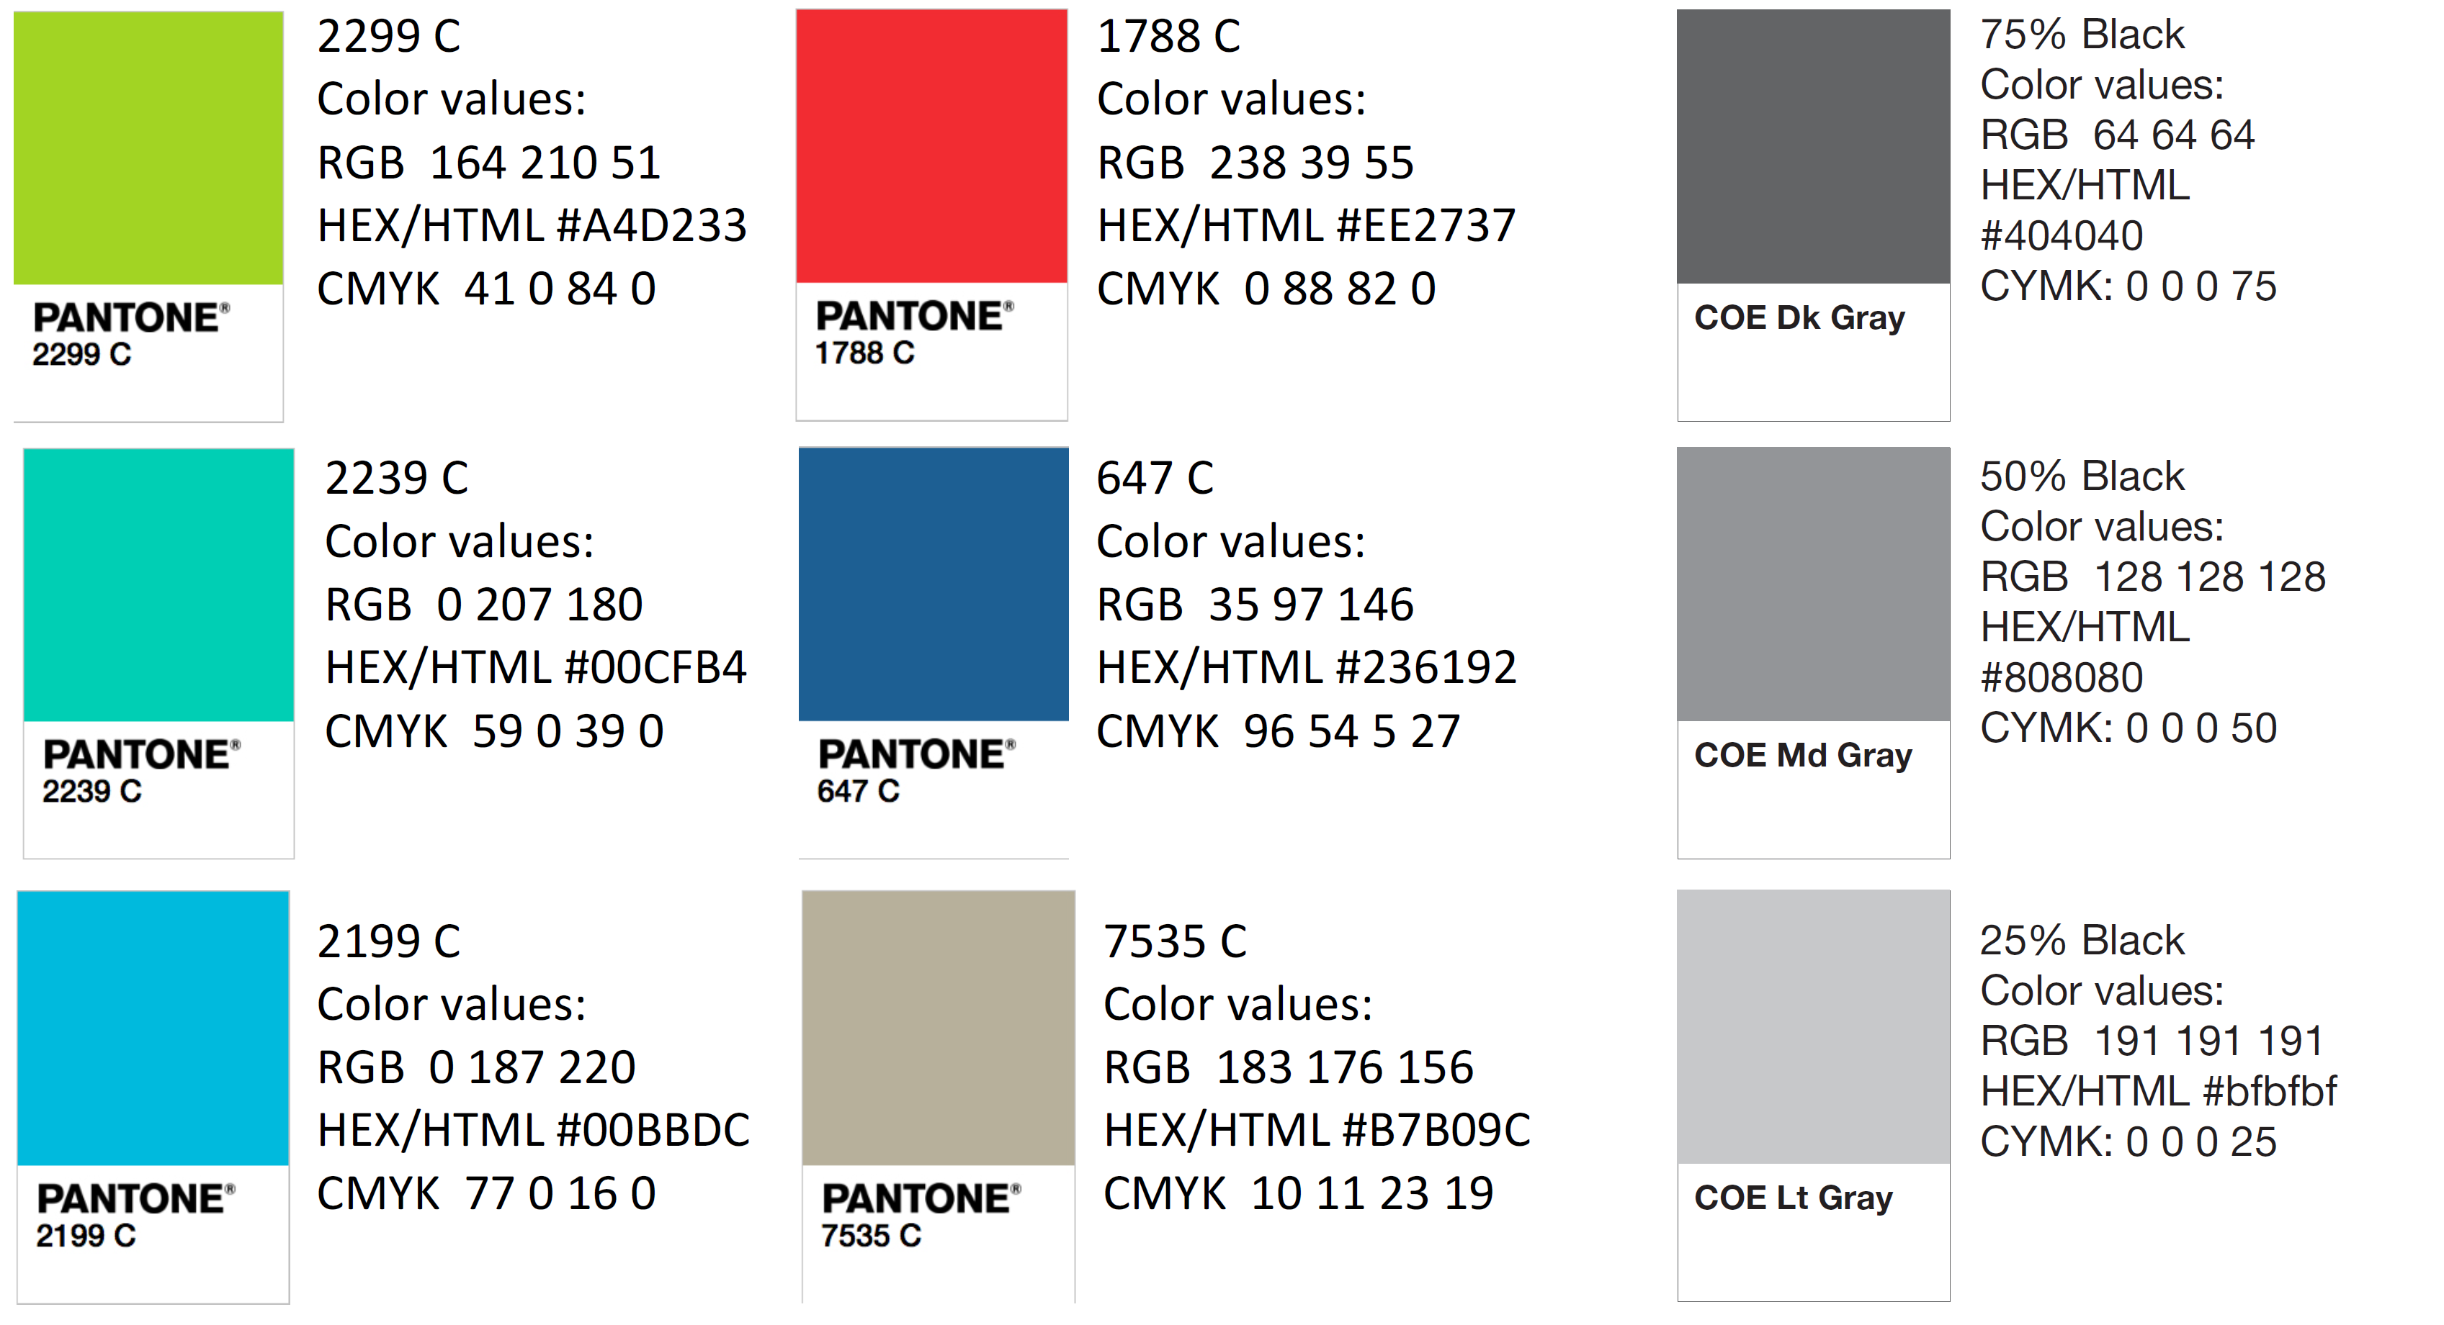
Color Palette
How do you think current control surfaces and their actuation can be improved? | Current control surfaces require clean flow, which is not realistic at high angles of attack, so that’s something. | Projectile accommodates for attached flow over control surfaces.
What draw backs come with standard fin deflections as a control surface? | Must have clean flow to actuate properly. Size and weight that come with actuation mechanism | Projectile control surfaces will be suitable effective even in detached flow.
What Mach numbers would be expected for this projectile? | FCAAP polysonic wind tunnel can’t go faster than Mach 5. We’ll probably test Mach 4. | The projectile can withstand Mach 4.
What slenderness ratio of the projectile would be appropriate? | Would be nice if it could be tied into what we have done already. Matching a baseline design here at FCAAP. 8-10 | The projectile uses a basic axisymmetric body configuration based on previously tested models.

